Slide 1
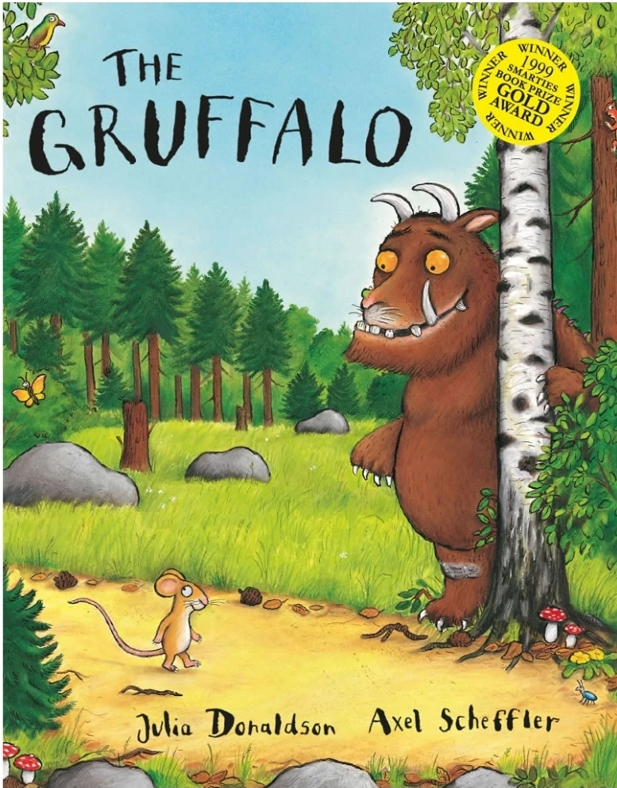
Week 1 – The Gruffalo
Monday – Character description of the Gruffalo. What words are used throughout the story to describe him?
Tuesday – Gruffalo food menu. Throughout the story, the mouse talks about the Gruffalo’s ‘favourite foods’. Use these to make a menu for a Gruffalo themed cafe.
Wednesday – Think about what you would do if you met the Gruffalo. What would you say? Would you trick the Gruffalo like the mouse did? Write about it using the title ‘If I met the Gruffalo...’.
Thursday – Create your own Gruffalo. Design your own fictional Gruffalo character with different features to the original. Draw/colour it and then label the main features.
Friday – Identifying rhyming pairs in the story. Can you spot the rhyming words in the story? Write down or record any rhyming pairs you can find.

Slide 2
Week 2 – Zog
Monday - What skills must Zog learn at dragon school? Write a list of these skills, titled ‘How to become a dragon...’
Tuesday – In the story, the princess dreams of being something else when she grows up. Can you write a dream for yourself for when you grow up? What do you want to be, and why?
Wednesday – Imagine you were flying on the back of Zog. What would you see whilst you were up in the air, and where would you choose to go?
Thursday – Imagine you have arrived at your chosen destination after Zog has flown you there. Can you write a postcard from that place to the people back at home?
Friday – Zog’s ‘super power’ is being able to fly. If you could have a super power, what would it be, and why?

Slide 3
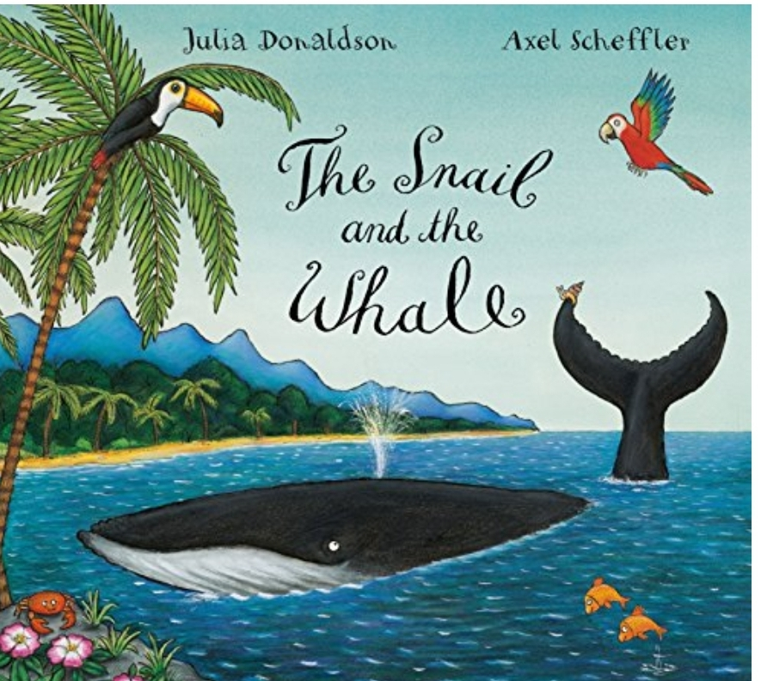
Week 3 – The Snail and the Whale
Monday – Choose one of the places that the snail and the whale visit and write a diary entry as the snail about her time there.
Tuesday – In the story, the whale gets stuck on the beach. Can you write a letter to the school children asking for their help to save the whale?
Wednesday – The snail and the whale travel across the ocean to visit many places together. Can you use the ocean as the main setting and write a description about it? (If they were in the middle of the ocean, what would they see around them, what would they hear, would they see other sea creatures?)
Thursday – Imagine you were the snail in the story and you could choose a place to visit with the whale. Where would you go? Write a list of items you would pack in your bag to take with you, and explain why you would take them.
Friday – If you could go on an adventure on the back of the whale, who would you take with you, and why?

Slide 4
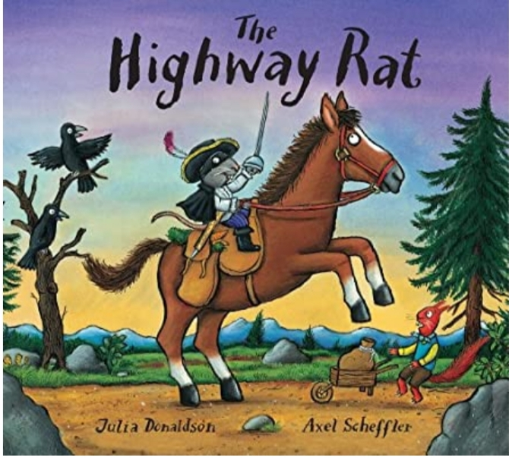
Week 4 – The Highway Rat
Monday – In the story, the Highway Rat steals from others around him. Can you make a wanted poster for the Highway Rat, listing his name, what he looks like and his crimes?
Tuesday – At the end of the story, the cunning duck becomes the hero of the story by saving the day. If you were the hero in the story, what would you do to stop the Highway Rat from stealing? How would you help?
Wednesday – Can you write a book/story review of the Highway Rat? What did you like/dislike about the story, and why? Is there anything you would have changed about it?
Thursday – The Highway Rat finally gets caught out for his unkind acts towards others. Can you make a newspaper report about the moment he is caught out and what happens to him?
Friday – Can you write an apology from the Highway Rat to the other animals that he stole from to say sorry for what he had done and ask for their forgiveness?

Slide 5
Week 5 – Room on the Broom
Monday – Design a new and improved broom for the witch and her friends. Draw a picture of it and label its key features.
Tuesday – Create a potion that the witch can use to make the new broom. What ingredients would be needed to make it? Write a recipe for your potion.
Wednesday – Create a magic spell for the witch to say as she mixes the potion for the new broom.
Thursday – A terrible beast protects the witch from the dragon at the end of the story. Who is this terrible beast and how does it save the witch? Was it such a ‘terrible’ beast after all?
Friday – Where should the witch and her friends travel next on the broom? What could be their next adventure together? Write about what it could be and draw a picture to go with it.

