Slide 1
Multiplication
using arrays

Slide 2
We are learning:
Solve one-step problems involving multiplication by calculating the answer using arrays.
WILF (What I’m Looking For):
I can solve multiplication problems using arrays.

Slide 3
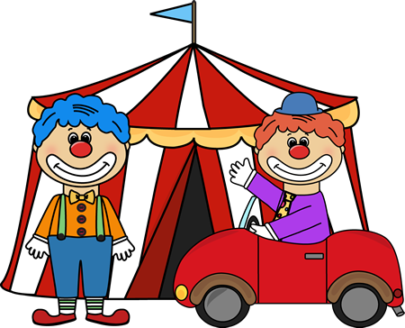
This week we will learn how to solve multiplication problems using the array method!

Slide 4
Let’s see all the words we need to use when solving multiplication problems.
groups of
Lot’s of
Times
multiply
Sets of

Slide 5
What Math symbols do you think we will be using today for multiplication? Point!
+
=
-
x

Slide 6
How do we solve problems using the array method?
Let’s try and solve this…
2 x 3 = ?
What is the first number?
2
We draw 2 circles.

Slide 7
Now what is the second number? 3
So draw circles at the bottom to have 3 groups of 2.
Then

Slide 8
Remember to draw the circles carefully!
Remember to draw the circles carefully!
2
3
2 x 3 = ___
Now add all the circles together to find the answer! 6

Slide 9
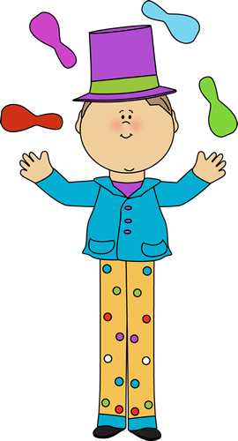
This is a list of what you need to do when trying to work out the answer: 1. Look at the first number and draw circles! 2. look at the second number and draw the remaining circles to show ‘groups of’. 3. add all the small circles together to get the answer.

Slide 10
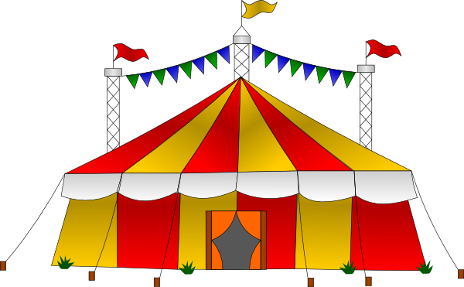
Let’s have a go!

Slide 11
2 x 4 = ___
Draw your working out in this box!

Slide 12
3 x 4 = ___
Draw your working out in this box!

Slide 13
4 x 5 = ___
Draw your working out in this box!

Slide 14
5 x 2 = ___
Draw your working out in this box!

Slide 15
5 x 4 = ___
Draw your working out in this box!

Slide 16
6 x 3 = ___
Draw your working out in this box!

Slide 17
7 x 5 = ___
Draw your working out in this box!

Slide 18
5 x 6 = ___
Draw your working out in this box!

Slide 19
Time to use your Multiplication brains!
Can you create and solve some questions of your own?
Mr Cash says…Challenge Yourself!

