Slide 1
LIFE/work balance
We have started a #LIFEworkbalance campaign and we need your help to complete our LIFE/work balance survey.
We hope to publish the results soon, so please give 15 minutes of your time to help us get a true picture of school life.
Want to be a part of this campaign? Take the survey on our website and share it with your colleagues!
© Classroom Secrets Limited 2019

Slide 2
Year 3/4 – Summer Block 5 – Mass & Capacity – Step 6
About This Resource:
This PowerPoint has been designed to support your teaching of this small step from the Mixed Age planning. It includes a starter activity suitable for each year group and an example of each question from the Varied Fluency and Reasoning and Problem Solving resources also provided in this pack (separate for each year group). Each slide has the year group identified in the bottom right-hand corner. We recommend that you look through this PowerPoint in advance and decide whether to work through all examples provided or a selection of them depending on the needs of your class.
National Curriculum Objectives:
Mathematics Year 3: (3M1c) Compare volume/capacity (l/ml)
Mathematics Year 3: (3M2c) Measure volume/capacity (l/ml)
More Year 3 and Year 4 Mass and Capacity resources.
Did you like this resource? Don’t forget to review it on our website.
© Classroom Secrets Limited 2018

Slide 3
Year 3/4 – Summer Block 5 – Mass and Capacity
Step 6
Year 3: Measuring Capacity 2
© Classroom Secrets Limited 2018

Slide 4
Introduction
What is the volume in each container?
L
1
9
8
7
6
5
4
3
2
1
ml
1000
900
800
700
600
500
400
300
200
100
ml
1000
800
600
400
200
L
10
8
6
4
2
Y3
© Classroom Secrets Limited 2018

Slide 5
Introduction
What is the volume in each container?
L
1
9
8
7
6
5
4
3
2
1
ml
1000
900
800
700
600
500
400
300
200
100
ml
1000
800
600
400
200
L
10
8
6
4
2
4 Litres | 950ml | 750ml | 5 Litres
Y3
© Classroom Secrets Limited 2018

Slide 6
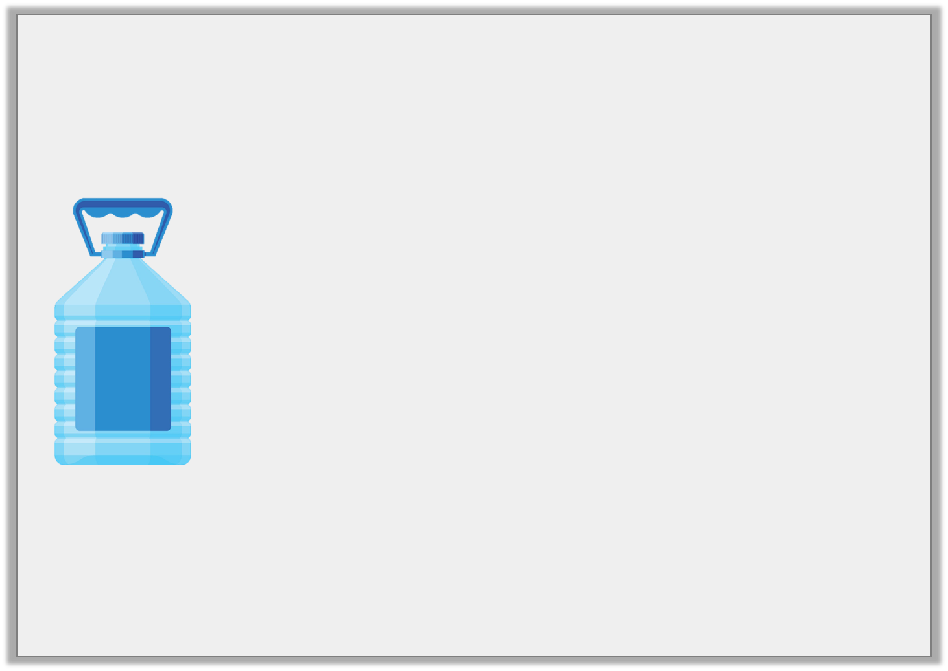
Varied Fluency 1
What is the capacity of the water bottle?
ml
1L
800
600
400
200
ml
1L
800
600
400
200
ml
1L
800
600
400
200
ml
1L
800
600
400
200
ml
1L
800
600
400
200
Y3
© Classroom Secrets Limited 2018

Slide 7
Varied Fluency 1
What is the capacity of the water bottle?
ml
1L
800
600
400
200
ml
1L
800
600
400
200
ml
1L
800
600
400
200
ml
1L
800
600
400
200
ml
1L
800
600
400
200
4L and 150ml
Y3
© Classroom Secrets Limited 2018

Slide 8
Varied Fluency 2
Colour the containers to show the given volume.
2L and 950ml
ml
1L
800
600
400
200
ml
1L
800
600
400
200
ml
1L
800
600
400
200
ml
1L
800
600
400
200
ml
1L
800
600
400
200
Y3
© Classroom Secrets Limited 2018

Slide 9
Varied Fluency 2
Colour the containers to show the given volume.
2L and 950ml
ml
1L
800
600
400
200
ml
1L
800
600
400
200
ml
1L
800
600
400
200
ml
1L
800
600
400
200
ml
1L
800
600
400
200
Y3
© Classroom Secrets Limited 2018

Slide 10
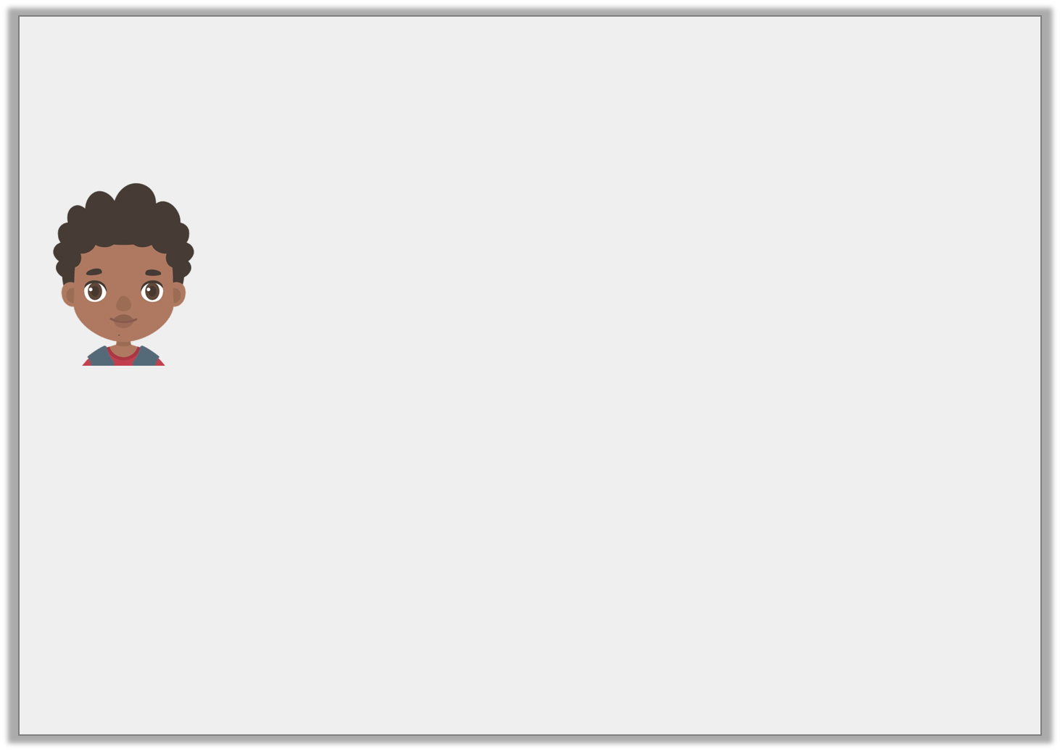
Varied Fluency 3
True or false?
ml
2L
1L 800ml
1L 600ml
1L 400ml
1L 200ml
1L
800ml
600ml
400ml
200ml
0
I have 1L and 600ml of pea soup for the school dinner hall.
Y3
© Classroom Secrets Limited 2018

Slide 11
Varied Fluency 3
True or false?
False. He has 1L and 500ml.
ml
2L
1L 800ml
1L 600ml
1L 400ml
1L 200ml
1L
800ml
600ml
400ml
200ml
0
I have 1L and 600ml of pea soup for the school dinner hall.
Y3
© Classroom Secrets Limited 2018

Slide 12
Varied Fluency 4
How much fluid is there in total?
ml
2L
1L 800ml
1L 600ml
1L 400ml
1L 200ml
1L
800ml
600ml
400ml
200ml
ml
2L
1L 800ml
1L 600ml
1L 400ml
1L 200ml
1L
800ml
600ml
400ml
200ml
ml
2L
1L 800ml
1L 600ml
1L 400ml
1L 200ml
1L
800ml
600ml
400ml
200ml
Y3
© Classroom Secrets Limited 2018

Slide 13
Varied Fluency 4
How much fluid is there in total?
ml
2L
1L 800ml
1L 600ml
1L 400ml
1L 200ml
1L
800ml
600ml
400ml
200ml
ml
2L
1L 800ml
1L 600ml
1L 400ml
1L 200ml
1L
800ml
600ml
400ml
200ml
ml
2L
1L 800ml
1L 600ml
1L 400ml
1L 200ml
1L
800ml
600ml
400ml
200ml
400ml | 600ml | 1L and 200ml
400ml + 600ml + 1L and 200ml = 2L and 200ml
Y3
© Classroom Secrets Limited 2018

Slide 14
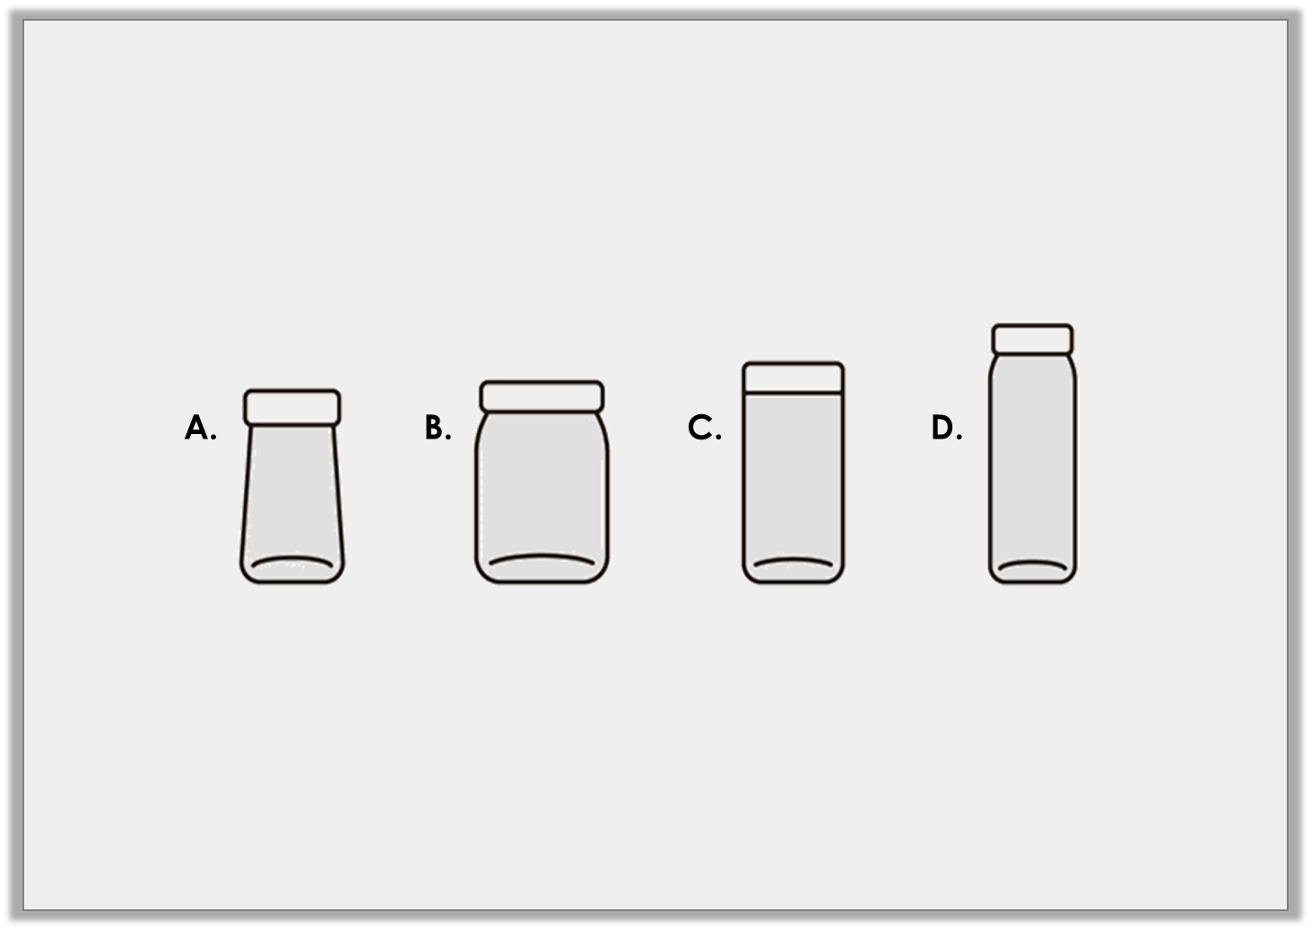
Problem Solving 1
Carl fills the measuring cylinder with liquid. The volume is more than 1L and 400ml but less than 1L and 600ml. Which of these containers could he fill exactly?
1L and 200ml
1L and 650ml
1L and 900ml
1L and 500ml
Y3
© Classroom Secrets Limited 2018

Slide 15
Problem Solving 1
Carl fills the measuring cylinder with liquid. The volume is more than 1L and 400ml but less than 1L and 600ml. Which of these containers could he fill exactly?
✓
1L and 200ml
1L and 650ml
1L and 900ml
1L and 500ml
Y3
© Classroom Secrets Limited 2018

Slide 16
Reasoning 1
Maisie is measuring water. She says,
Explain her mistake.
One is nearly 1L and 600ml and the other is 2L so there is 3L and 600ml in total.
ml
2L
1L 800ml
1L 600ml
1L 400ml
1L 200ml
1L
800ml
600ml
400ml
200ml
ml
2L
1L 800ml
1L 600ml
1L 400ml
1L 200ml
1L
800ml
600ml
400ml
200ml
Y3
© Classroom Secrets Limited 2018

Slide 17
Reasoning 1
Maisie is measuring water. She says,
Explain her mistake.
Maisie hasn’t read the scale accurately on…
One is nearly 1L and 600ml and the other is 2L so there is 3L and 600ml in total.
ml
2L
1L 800ml
1L 600ml
1L 400ml
1L 200ml
1L
800ml
600ml
400ml
200ml
ml
2L
1L 800ml
1L 600ml
1L 400ml
1L 200ml
1L
800ml
600ml
400ml
200ml
Y3
© Classroom Secrets Limited 2018

Slide 18
Reasoning 1
Maisie is measuring water. She says,
Explain her mistake.
Maisie hasn’t read the scale accurately on the first measuring cylinder. It actually reads 1L and 500ml, so there is 3L and 500ml in total.
One is nearly 1L and 600ml and the other is 2L so there is 3L and 600ml in total.
ml
2L
1L 800ml
1L 600ml
1L 400ml
1L 200ml
1L
800ml
600ml
400ml
200ml
ml
2L
1L 800ml
1L 600ml
1L 400ml
1L 200ml
1L
800ml
600ml
400ml
200ml
Y3
© Classroom Secrets Limited 2018

Slide 19
Reasoning 2
Carson says,
Do you agree? Explain your answer.
Container B has the least amount of liquid as the scale only goes up to 500ml.
ml
500
400
300
200
100
ml
1L
800
600
400
200
ml
2L
1L 500ml
1L
500
A.
B.
C.
Y3
© Classroom Secrets Limited 2018

Slide 20
Reasoning 2
Carson says,
Do you agree? Explain your answer.
Carson is correct because…
Container B has the least amount of liquid as the scale only goes up to 500ml.
ml
500
400
300
200
100
ml
1L
800
600
400
200
ml
2L
1L 500ml
1L
500
A.
B.
C.
Y3
© Classroom Secrets Limited 2018

Slide 21
Reasoning 2
Carson says,
Do you agree? Explain your answer.
Carson is correct because container B only has 450ml, which is less than in containers A and C, although his reasoning is incorrect.
Container B has the least amount of liquid as the scale only goes up to 500ml.
ml
500
400
300
200
100
ml
1L
800
600
400
200
ml
2L
1L 500ml
1L
500
A.
B.
C.
Y3
© Classroom Secrets Limited 2018

