Slide 1
Who Were the Israelites?
The Israelites were a group of people who followed the Jewish faith thousands of years ago.
The first follower of the faith was a man named Abraham. Over a number of years, the amount of people belonging to Judaism grew.
Hundreds of years later, one of Abraham’s descendants, Joseph, was sold into slavery in Egypt. Through his ability to interpret dreams, Joseph eventually rose to a position of power in the country. The Israelites moved to Egypt and made it their home.

Slide 2
Who Were the Israelites?
Over time, the Israelites prospered in Egypt and their numbers continued to grow. Eventually, Egypt had a new Pharaoh who resented the success of the Israelites. He gathered the leaders of Egypt and said, “There are now more Israelites than Egyptians in our country. We must make a plan to keep them from growing even more. If we don’t, they may one day fight with our enemies against us.”
The Israelites were forced into slavery and were held in terrible conditions. Yet no matter how badly the Israelites were treated, their numbers continued to grow.
Eventually, the Pharaoh devised a dreadful plan. He would have all the Israelites’ firstborn sons killed.

Slide 3
Who Were the Israelites?
An Israelite named Jochabed managed to hide her son, Moses. Through a series of unusual events, Moses ended up being raised in the Pharaoh’s palace, unaware that he was an Israelite.
As an adult, Moses discovered his true identity. God chose Moses as his messenger. Moses was to tell the Pharaoh to free the Israelites from slavery.
By this time, a new pharaoh ruled Egypt but the Israelites were living in terrible conditions.
Moses, along with his brother Aaron, visited the Pharaoh and requested that the Israelites be allowed to worship God in the desert. The Pharaoh refused and issued orders for the enslaved Israelites to be treated even more badly than before.

Slide 4
The Plague of Blood
Moses returned to the Pharaoh. “To show you how powerful God is, Aaron will strike the river Nile with his stick. Then, God will turn the river to blood. There will be no fish to eat and no water to drink.”
Aaron struck the river with his stick and all the water instantly turned to blood. The plague lasted for seven days yet the Pharaoh refused to free the Israelites.

Slide 5
The Plague of Frogs
God told Moses to return to the Pharaoh and again request that the Israelites be allowed to worship in the desert. “Tell the Pharaoh,” said God, “if you won’t let my people go, I will send a plague of frogs across all of Egypt. The Nile river will swarm with frogs. They will come up out of the river and into your palace, even into your bedroom and on to your bed! They will enter all the houses, jumping on the furniture, food and people.”
The frogs appeared just as God had said.
The Pharaoh begged for Moses to make the frogs disappear, promising he would release the Israelites in return. However, once the frogs had gone, the Pharaoh went back on his word.

Slide 6
The Plagues of Gnats and Flies
Twice more Moses visited the Pharaoh with warnings of plagues that would descend on Egypt if the Israelites were not freed. The third plague to arrive was one of gnats that covered every living thing. The fourth was a plague of flies that filled the air. During each one, the Pharaoh promised to free the Israelites. However, once each plague was removed, the Pharaoh refused to let the enslaved people go free.

Slide 7
The Plagues of Livestock and Boils
The next plague was against Egyptian animals. None of the animals belonging to the Israelites were harmed but still the Pharaoh refused to let the Israelites go.
Then, God told Moses to take a handful of soot and throw it in the air in front of the Pharaoh. Moses did as God commanded. As the soot flew through the air, painful boils appeared on the skin of all the Egyptians.
As before, each time the plague ended, the Pharaoh wouldn’t let the Israelites go.

Slide 8
The Plague of Hail
God told Moses, “I am going to send Egypt the worst hailstorm there has ever been. Tell your people to get themselves and their animals safely indoors.” The Israelites did as Moses commanded them. Starting with a tremendous thunderstorm, the hailstorm left all of Egypt in ruins. Still the Israelites remained enslaved.

Slide 9
The Plagues of Locusts and Darkness
Then, came two more plagues. An east wind blew a plague of locusts into Egypt. They ate every plant in the land until there wasn’t even a single leaf remaining.
The ninth plague was complete darkness which covered Egypt. For three days, there was no light, except for in the area where the Israelites lived.
“You may go” the Pharaoh told Moses, “as long as you leave your animals here.” Moses refused, saying the Israelites would take all their belongings with them.
“Get out of here!” the Pharaoh shouted at Moses. “I’m warning you. Never come back to see me again!”
“Alright,” Moses replied. “You will never see me again.”

Slide 10
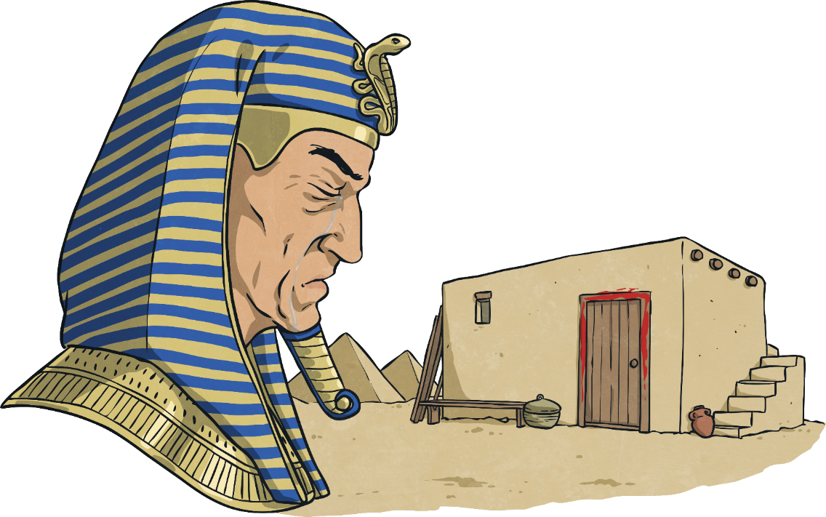
The Plague of the Firstborn
Moses told the Israelites to put blood above their doorposts. That night, the angel of death travelled through Egypt, killing the firstborn of every family. The Israelites remained safe.
The Pharaoh finally agreed to free the Israelites. Having lived in Egypt for 430 years, hundreds of them in slavery, the Israelites were finally free.

