Slide 2
Learning outcome
To recognise the features of haiku poems.

Slide 3
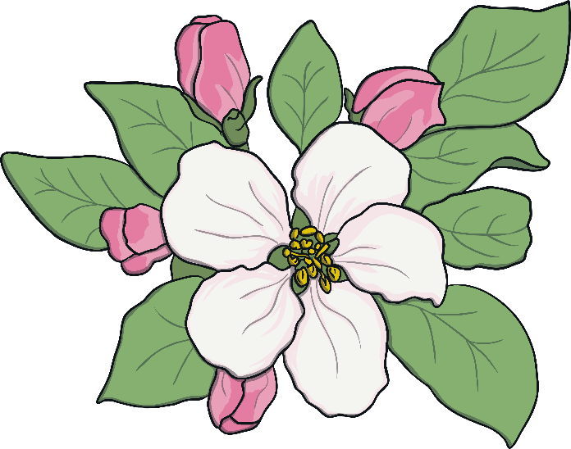
What is a haiku?
Haiku poems are a traditional Japanese art form. Here’s one...
My two plum trees are
So gracious. See, they flower.
One now, one later.

Slide 4
What is a haiku? Watch this video…
https://www.bbc.co.uk/teach/class-clips-video/english-ks1-ks2-understanding-poetry/zfvkt39

Slide 5
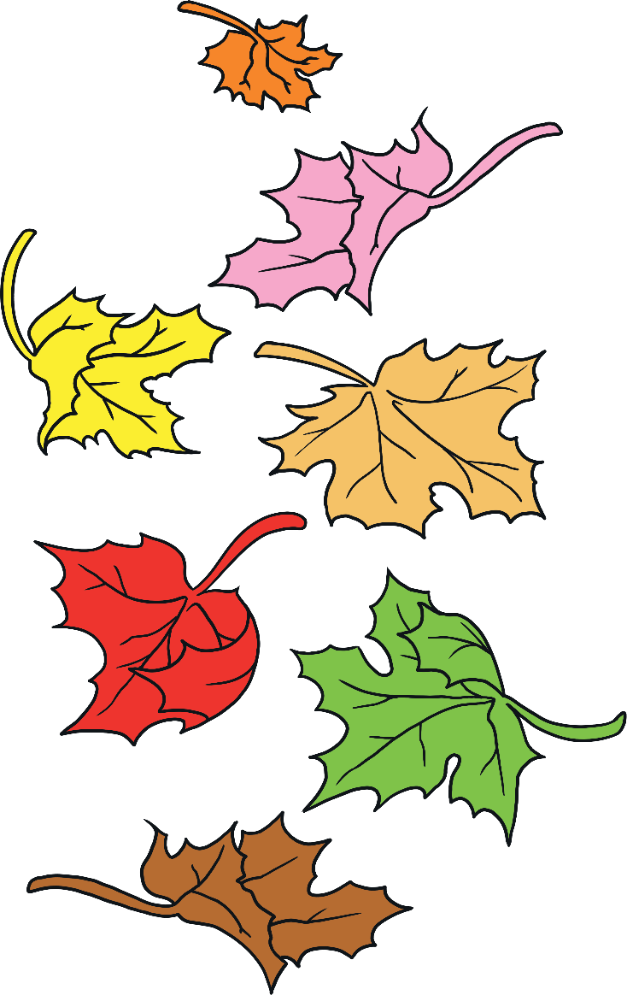
What is a haiku?
Here’s another…
Winter is coming.
Snow will be arriving soon.
We should rake the leaves.

Slide 6
What is special about a haiku?
What did you notice about the poems?
Think about:
the poem’s theme;
how many lines are in each poem;
how many syllables in each line.
My two plum trees are
So gracious. See, they flower.
One now, one later.
Winter is coming.
Snow will be arriving soon.
We should rake the leaves.

Slide 7
Haiku key features
1.There are 3 lines in the poem.
2. They follow this pattern:
1st line – 5 syllables
2nd line – 7 syllables
3rd line – 5 syllables
3. They are often about nature or the seasons

Slide 8
Let’s have a go!
How can we write a haiku?
Pick a theme (a hobby, or special place where you like to go for a walk), and create a word bank.

Slide 9
Now we have our ideas, try to fit them into the haiku format.
You might have to alter words or phrases slightly fit the pattern.
1st line – 5 syllables
2nd line – 7 syllables
3rd line – 5 syllables

Slide 10
What have we learned about haiku?
Each poem has only 3 lines.
The syllable pattern of the poem should be 5-7-5.
Haiku are often written about seasons and nature.

