Slide 1
Recognise this?

Slide 2
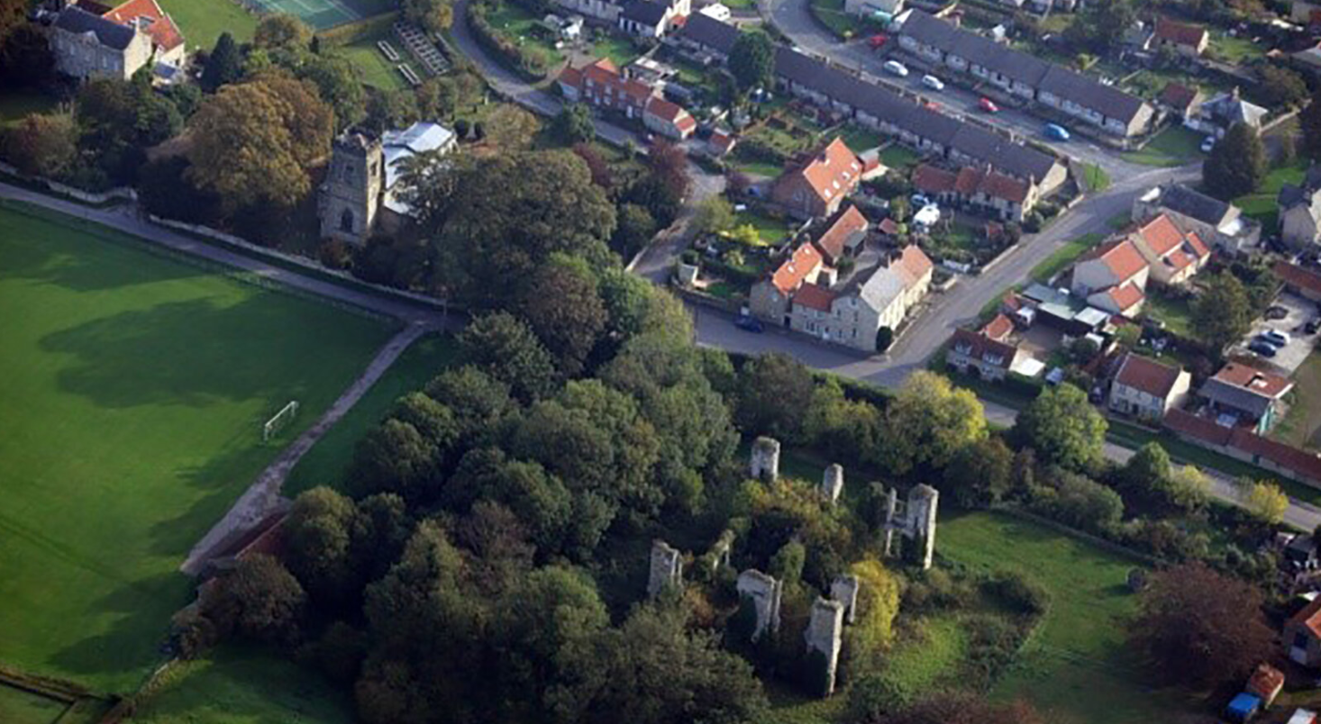

Slide 3
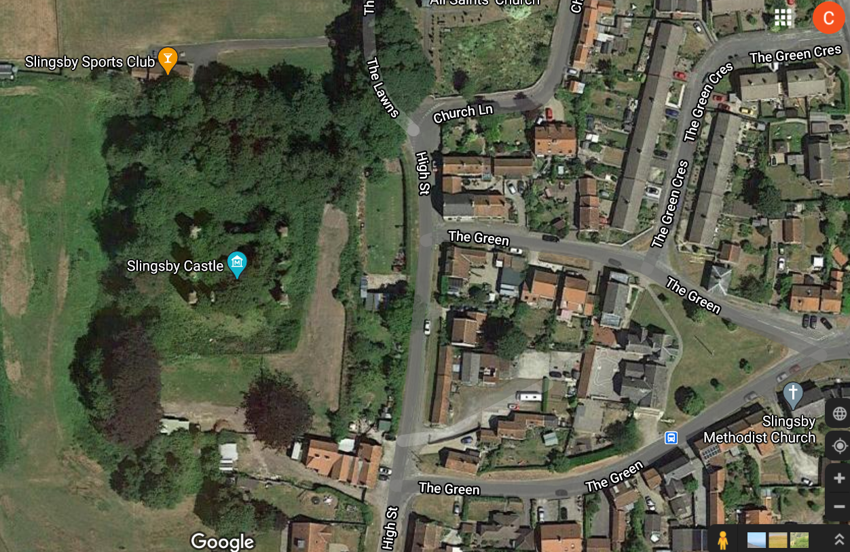

Slide 4
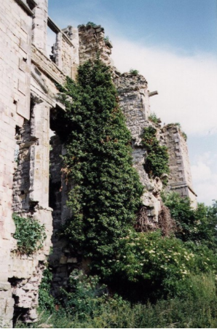
What do you think the castle looked like when it was built?
Have a go at sketching it

Slide 5
Plan of the castle from 1700

Slide 6
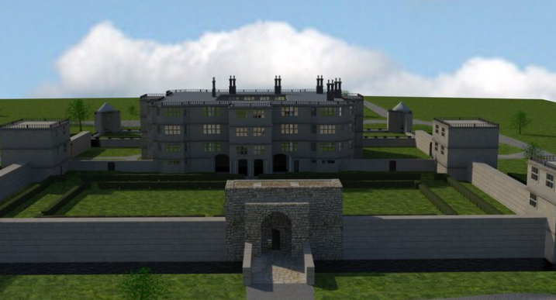
3D reconstructions of the castle

