Slide 1
96 ÷ 6 =
What is the question asking us?
If we shared 96 into 6 equal groups, how many would be in each group?
Or …
How many equal groups of 6 are in 96?

Slide 2
Division by Chunking
96 ÷ 6 =
We'll still have our number line as before, but we're not
going to count in single groups of 6. We're going to
count in several groups of 6 at a time.
0
96

Slide 3
Division by Chunking
96 ÷ 6 =
I'm going to make it easy for myself, by picking easy multiples
of 6.
I know 10 multiples of 6 is 60. so I'm going to start there.
10 x 6
60
0
96

Slide 4
Division by Chunking
96 ÷ 6 =
Another hop of 10 groups of 6 would take me to 120,
well over my 96, so another easy multiple to work with
is 5.
6 x 10
60
0
96

Slide 5
Division by Chunking
96 ÷ 6 =
6 x 10
6 x 5
60
90
0
96

Slide 6
Division by Chunking
96 ÷ 6 =
Now we're up to 90. How many more whole groups of 6 can we
fit in?
6 x 10
6 x 5
60
90
0
96

Slide 7
Division by Chunking
96 ÷ 6 =
6 x 10
6 x 5
6 x 1
60
90
0
96

Slide 8
Division by Chunking
96 ÷ 6 =
Now we need to add up the total number of groups of 6
we have jumped, by looking at our multiplying numbers.
6 x 10
6 x 5
6 x 1
60
90
0
96

Slide 9
Division by Chunking
96 ÷ 6 =
10 groups, add 5 groups add 1 group.
10 + 5 + 1 = 16 groups of 6
6 x 10
6 x 5
6 x 1
60
90
0
96
Our final answer to 96 ÷ 6 = 16!

Slide 10
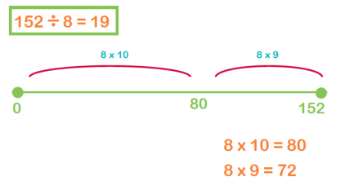
Your Turn…
Have a look at the questions for your year group on the home learning plan for Thursday.
Draw a number line for each linear calculation to work out the answer as we just have.

