Slide 1
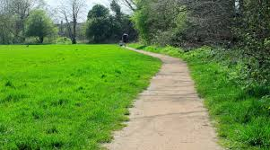

Slide 3
Can you play around with this silly sentence?
The goat got on a boat.
What other “oa” words could you use?

