Slide 1
Kenning poems
LO: I know what the features of a kenning poem are.

Slide 2
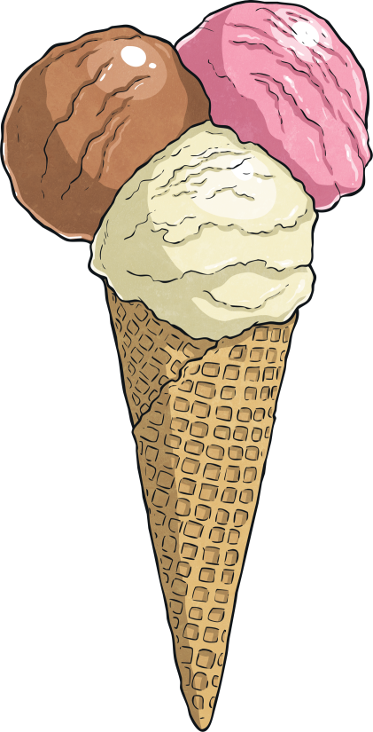
What is a kenning?
Kennings are like riddles.
They describe something without ever saying what it is.
Read these phrases out loud. What could they be describing?
lip-licking
sauce-swirling
chin-dripping
cone-filling
flake-holding
tongue-freezing

Slide 3
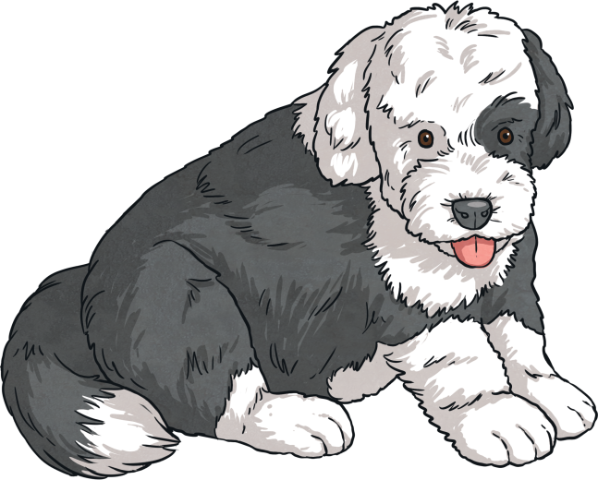
What is a kenning?
How about these?
tail-wagger
face-licker
ball-catcher
house-guardian
furry-friend
cat-chaser

Slide 4
What is a kenning?
What did you notice about the poems?
tail-wager
face-licker
ball-catcher
house-guardian
furry-friend
cat-chaser
lip-licking
chin-dripping
sauce-swirling
cone-filling
flake-holding
tongue-freezing

Slide 5
What is a kenning?
What did you notice about the phrases in each poem?
Each line of the poem is made of a two-word phrase.
The words are joined by a hyphen.
house-guardian
furry-friend
lip-licking
chin-dripping
Here the phrases are made up of a noun + a verb (the verb usually ends in -ing).
Here the phrases are made up of a noun + a noun.

Slide 6
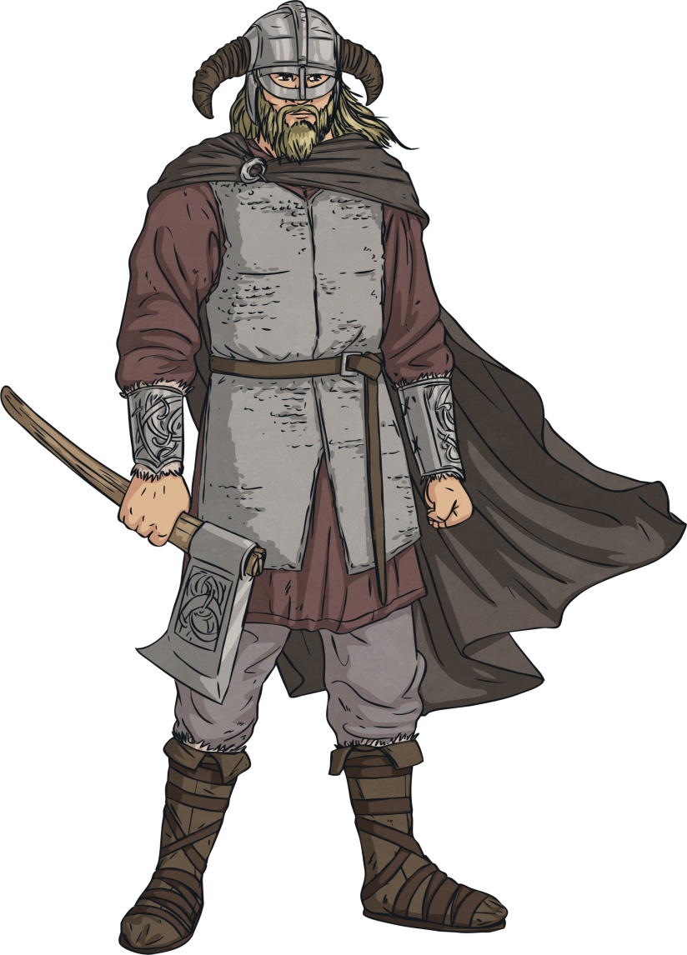
Did you know?
The two-word format for a kenning relates to the Old Norse tradition of naming things like weapons, e.g. Skull-Splitter or Blood-Taker.
Kennings came into our language via the Anglo-Saxon and Norse cultures. These people came from what is now Scandinavia and northern Germany.
The word ‘kenning’ derives from the Old Norse word ‘kenna eitt við’, which means ‘to express a thing in terms of another’.

Slide 7
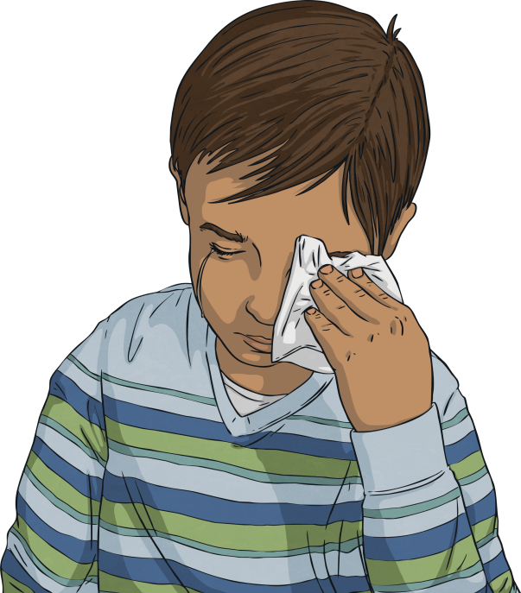
We even use them in everyday language!
How do we describe a very tall building?
A really sad film or story is often called a...
Oh look – here’s some alliteration! Other poetic devices can also be found in kennings.
sky-scraper
tear-jerker

Slide 8
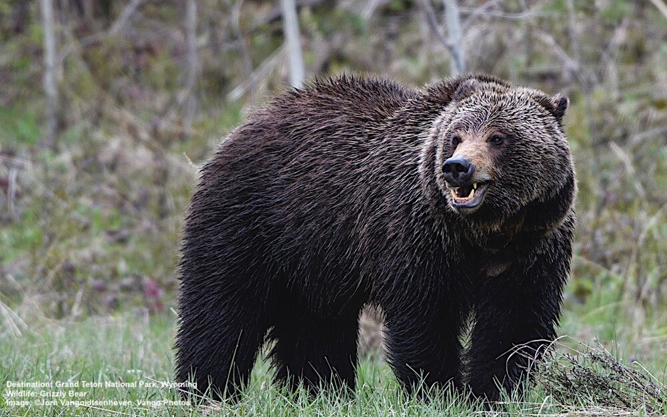
What is this kenning about?
BEwARe!
by James Carter
There's a ...
jaw-snapper
teeth-gnasher
river-swimmer
dives-for-dinner
fish-catcher
back-scratcher
cave-seeker
winter-sleeper
forest-dweller
grizzly-fella

Slide 9
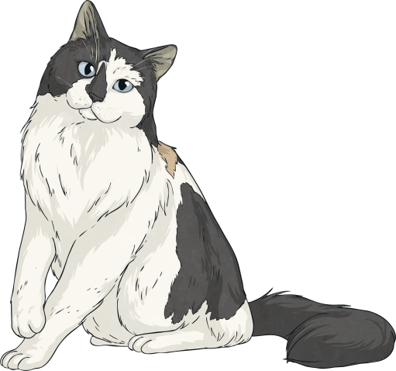
Let’s have a go!
How can we write a kenning?
First, we need to choose a theme. (It doesn’t have to be gory, like the Vikings!)
cat
Then, we brainstorm lots of words or phrases associated with that theme…
drinks milk
nuzzle
mice
sleeps a lot
fur
stalk
scratch
rubs ankles
purr
hunter
hates dogs
night

Slide 10
Let’s have a go!
How can we write a kenning?
To start creating your kenning, try and make a noun + noun phrase or a noun + verb phrase using your words.
nose
night
drinks milk
nuzzle
lick
stalk
ear
sleeps a lot
fur
scratch
purr
rubs ankles
hunter
night
hates dogs
mice

Slide 11
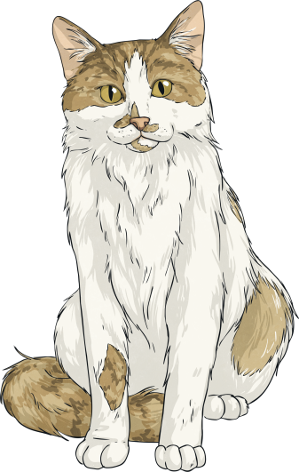
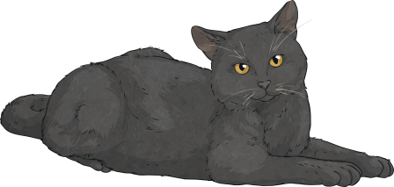
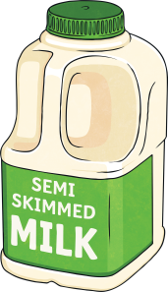
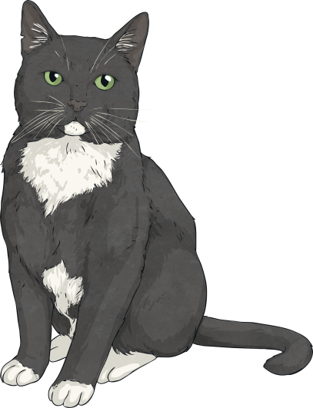
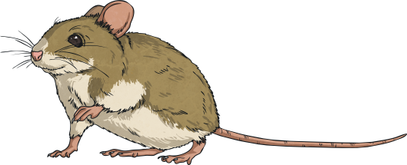
Let’s have a go!
How can we write a kenning?
Finally, put them together in your two-word phrases.
Don’t forget the hyphens!
mouse-hunter
milk-drinker
night-stalker
fur-licker
ankle-rubber
dog-hater
nose-nuzzler
ear-scratcher
loud-purrer

Slide 12
Let’s have a go!
Try writing your own kenning. Here are a few ideas...
teacher
football
mums or dads
pizza
winter
car
pets
Once you’ve chosen your theme, create a word bank, then start making your two-word phrases.

Slide 13
What have we learned about Kennings?
Kennings are like riddles – they describe a thing but don’t tell you its name.
They usually have only two words- a noun plus a noun OR a noun plus a verb.
Poetic devices like alliteration can be used.
They’re great when you read them out loud so you can imagine the thing being describe.

