Slide 2
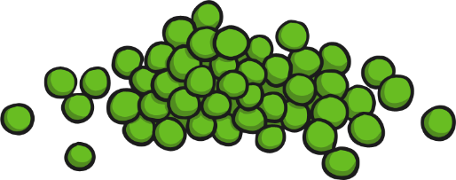
What Am I?
Click the numbers to reveal a clue. When you have guessed the fruit or vegetable, click the reveal answer button.
1
We grow in a pod.
2
We are small and round.
3
We are green.
We are peas!
Reveal Answer

Slide 3
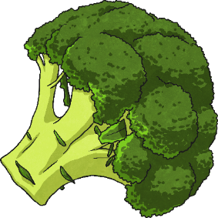
What Am I?
Click the numbers to reveal a clue. When you have guessed the fruit or vegetable, click the reveal answer button.
1
I am green.
2
I am cooked to eat.
3
I look like a little tree.
I am broccoli!
Reveal Answer

Slide 4
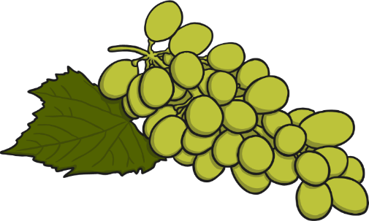
What Am I?
Click the numbers to reveal a clue. When you have guessed the fruit or vegetable, click the reveal answer button.
1
We grow in bunches.
2
We can be red or green.
3
We are small and sweet.
We are grapes!
Reveal Answer

Slide 5
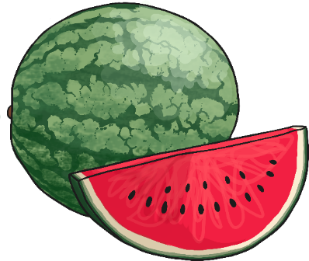
What Am I?
Click the numbers to reveal a clue. When you have guessed the fruit or vegetable, click the reveal answer button.
1
I am large.
2
I am green on the outside.
3
I am pink on the inside.
I am a watermelon!
Reveal Answer

Slide 6
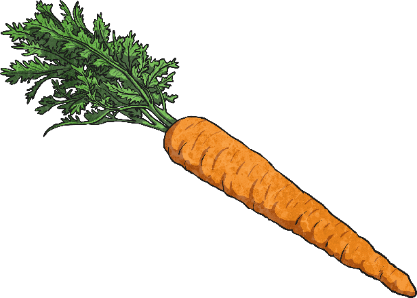
What Am I?
Click the numbers to reveal a clue. When you have guessed the fruit or vegetable, click the reveal answer button.
1
I grow in the ground.
2
I am crunchy if eaten raw.
3
I am orange.
I am a carrot!
Reveal Answer

Slide 7
What Am I?
Click the numbers to reveal a clue. When you have guessed the fruit or vegetable, click the reveal answer button.
1
I am round.
2
I am red or green.
3
I grow on trees.
I am an apple!
Reveal Answer

Slide 8
What Am I?
Click the numbers to reveal a clue. When you have guessed the fruit or vegetable, click the reveal answer button.
1
I taste sour.
2
I am yellow.
3
I have a rind.
I am a lemon!
Reveal Answer

Slide 9
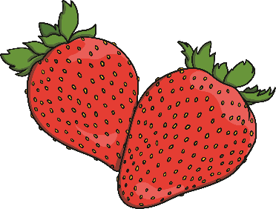
What Am I?
Click the numbers to reveal a clue. When you have guessed the fruit or vegetable, click the reveal answer button.
1
I am sweet.
2
I am red.
3
I am used in jam.
I am a strawberry!
Reveal Answer

Slide 10
What Am I?
Click the numbers to reveal a clue. When you have guessed the fruit or vegetable, click the reveal answer button.
1
I am round.
2
I have a peel.
3
I can be made into juice.
I am an orange!
Reveal Answer

Slide 11
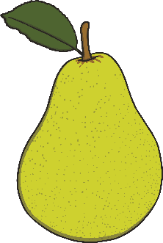
What Am I?
Click the numbers to reveal a clue. When you have guessed the fruit or vegetable, click the reveal answer button.
1
I am sweet.
2
I am green.
3
I rhyme with “share”.
I am a pear!
Reveal Answer

Slide 12
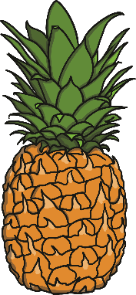
What Am I?
Click the numbers to reveal a clue. When you have guessed the fruit or vegetable, click the reveal answer button.
1
I am sweet.
2
I have a spikey top.
3
I have yellow flesh.
I am a pineapple!
Reveal Answer

Slide 13
What Am I?
Click the numbers to reveal a clue. When you have guessed the fruit or vegetable, click the reveal answer button.
1
I grow in the ground.
2
I can be white or red.
3
I like to be mashed!
I am a potato!
Reveal Answer

Slide 14
What Am I?
Click the numbers to reveal a clue. When you have guessed the fruit or vegetable, click the reveal answer button.
1
I am white.
2
I have green leaves.
3
I look like a little tree.
I am a cauliflower!
Reveal Answer

Slide 15
What Am I?
Click the numbers to reveal a clue. When you have guessed the fruit or vegetable, click the reveal answer button.
1
I grow in trees.
2
I have hard, yellow skin.
3
I am white inside.
I am a banana!
Reveal Answer

