Slide 1
Lesson 5: Event planning
Save a copy
Year 6 – Data and information – Introduction to spreadsheets
Notes:
This resource is available online at ncce.io/dat6-5-s. Resources are updated regularly — please check that you are using the latest version.
This resource is licensed under the Open Government Licence, version 3. For more information on this licence, see ncce.io/ogl.

Slide 2
Lesson 5: Event planning
Objectives
To create a spreadsheet to plan an event
I can use a spreadsheet to answer questions
I can explain why data should be organised
I can apply a formula to calculate the data I need to answer questions
Notes:
Primary – objectives slides

Slide 3
Planning an event
Introduction
During this lesson you will be planning a celebratory event for your class.
At the end of the lesson, you should be able to answer this question:
What is the total party cost for your event?
Notes:
Balloons: https://pixabay.com/vectors/balloons-red-blue-yellow-shiny-25737/

Slide 4
You will use a spreadsheet to calculate the costs involved
Activity 1
What will you choose?
You have the opportunity to choose:
One venue
Activities
Food
Drinks
Essentials/decorations
Notes:
Balloons: https://pixabay.com/vectors/balloons-red-blue-yellow-shiny-25737/
Spreadsheet: https://pixabay.com/vectors/spreadsheet-application-window-grid-147749/

Slide 5
Event planning
Activity 1
Introduction
Use the information to plan an event
for the end of Year 6.
Note: p.p. = per person
Venue hire School hall Hotel Bowling alley Laser Quest | (Cost) FREE £150.00 See activities p.p. See activities p.p. | Activity Disco Party games/prizes Bowling Laser Quest | (Cost) £150.00 £20.00 £5.95 p.p. £5.95 p.p.
(Note: Hot food only available for bowling/Laser Quest — plates provided) |  | Drinks Lemonade Cola Cherryade Blackcurrant juice Orange juice Water | (Cost) £0.04 per cup £0.04 per cup £0.06 per cup £0.03 per cup £0.03 per cup FREE
Hot food Burger Veggie burger Chicken nuggets Mozzarella bites Pizza Chips | (Cost) £2.95 p.p. £2.80 p.p. £2.65 p.p. £2.30 p.p. £3.00 p.p. £2.00 p.p.
Notes:
Bring the learners attention to the fact that p.p. means per person and this is the price per person at the event.
Discuss that hot food can only be ordered at bowling or Laser Quest and that bottles of drink hold approximately 5 cups per bottle.
Balloons: https://pixabay.com/vectors/balloons-red-blue-yellow-shiny-25737/

Slide 6
The budget
Activity 1
Attendees | Budget per person | Total budget
 | £15
The budget is £15 per person, so you would multiply this by the number of people in your class.
Notes:
Learners could use cell references and a formula to calculate the total budget (= Attendees (G2) * Budget per person (H2)). This would ensure that their budget would be altered if they change the number of attendees.

Slide 7
Budget and party choices
Activity 1
Item | Spending type | Cost | Quantity | Subtotal
Why are data headings important?
Think, pair, share: Why should data be organised?

Slide 8
What do you need to find out?
Activity 2
Item | Spending type | Cost | Quantity | Subtotal
Hotel | Venue | £150
Party games/prizes | Activity | £20.00
Lemonade (p.p.) | Drinks | £0.04
Cola (p.p.) | Drinks | £0.04
Sausage rolls (p.p.) | Food | £0.11
You can use the quantity column to help you populate the subtotal column!

Slide 9
What do you need to find out?
Activity 2
 | A | B | C | D | E | F | G
1 | Item | Spending type | Cost | Quantity | Subtotal |  | Attendees
2 | Lemonade (p.p.) | Drinks | £0.04 | = G2 * 1 |  |  | 30
3 | Cola (p.p.) | Drinks | £0.04
4 | Sausage rolls (p.p.) | Food | £0.11
5
Think, pair, share: What would happen if I entered this formula in the cell?

Slide 10
What do you need to find out?
Activity 2
 | A | B | C | D | E | F | G
1 | Item | Spending type | Cost | Quantity | Subtotal |  | Attendees
2 | Lemonade (p.p.) | Drinks | £0.04 | = G2 |  |  | 30
3 | Cola (p.p.) | Drinks | £0.04
4 | Sausage rolls (p.p.) | Food | £0.11
5
Multiplying by one does not change the value. It is the same as writing =G2

Slide 11
Add your quantity and subtotal data
Activity 2
 | A | B | C | D | E | F | G
1 | Item | Spending type | Cost | Quantity | Subtotal |  | Attendees
2 | Lemonade (p.p.) | Drinks | £0.04 |  |  |  | 30
3 | Cola (p.p.) | Drinks | £0.04
4 | Sausage rolls (p.p.) | Food | £0.11
5

Slide 12
The final figures
Activity 3
B
Spending type
Venue
Activity
Drinks
Drinks
Food
Food
Food
Essentials/decorations
Essentials/decorations
G | H
Party items | Overall Party Costs
Venue total cost
Activity total cost
Drinks total cost
Food total cost
Essentials/decorations total cost
Budget left over
Total party cost
Party cost per person
Calculate the total cost for each spending type.

Slide 13
The final figures
Activity 3
Activity total cost |  | H7 |  | Add all spending type activity subtotals
Drinks total cost |  | H8 |  | Add all spending type drinks subtotals
Food total cost |  | H9 |  | Add all spending type food subtotals
Activity total cost |  | H10 |  | Add all spending type essentials/decorations subtotals
Budget left over |  | H11 |  | Total budget subtract total party cost
Total party cost |  | H12 |  | Add all total costs for venue, activity, drinks, food, essentials/decorations
Party cost per person |  | H13 |  | Total party cost divided by attendees
Use your handout to complete your final figures. Remember to format your columns correctly!

Slide 14
Think, pair, share:
Can you answer the question using the data in your spreadsheet?
Activity 3
What is the total party cost for your event?
What other information could you tell me using the data on your spreadsheet?

Slide 15
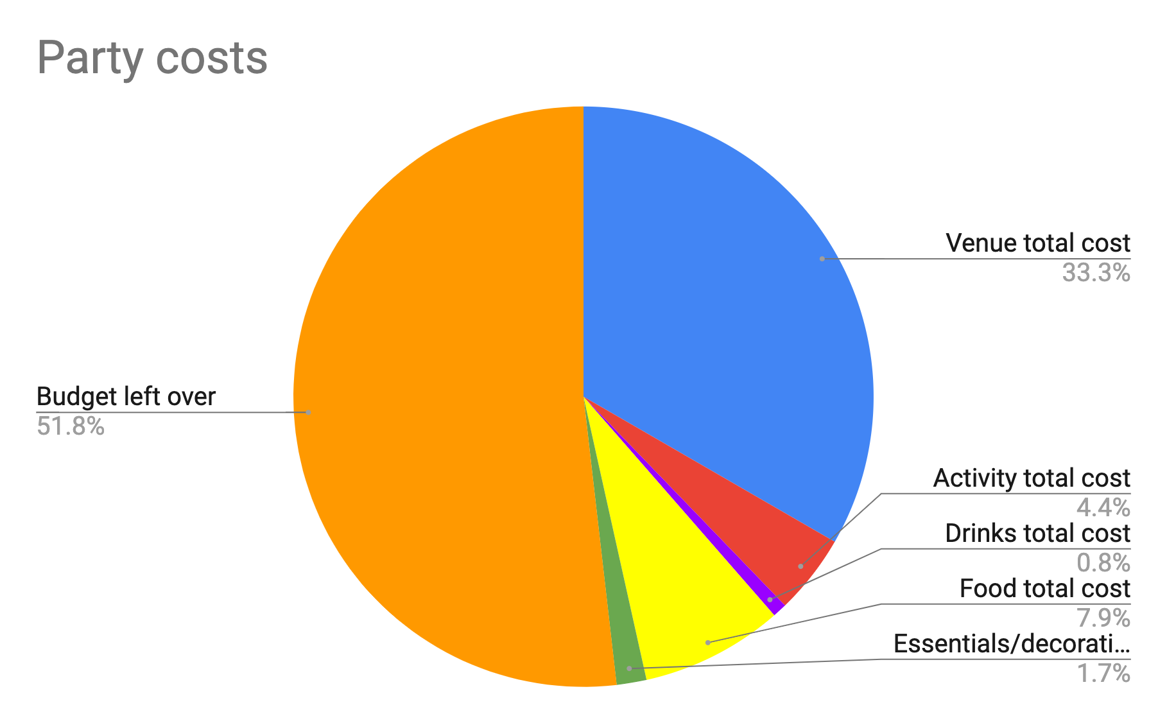
Creating graphs
Plenary
Think, pair, share: What does this pie chart tell you?

Slide 16
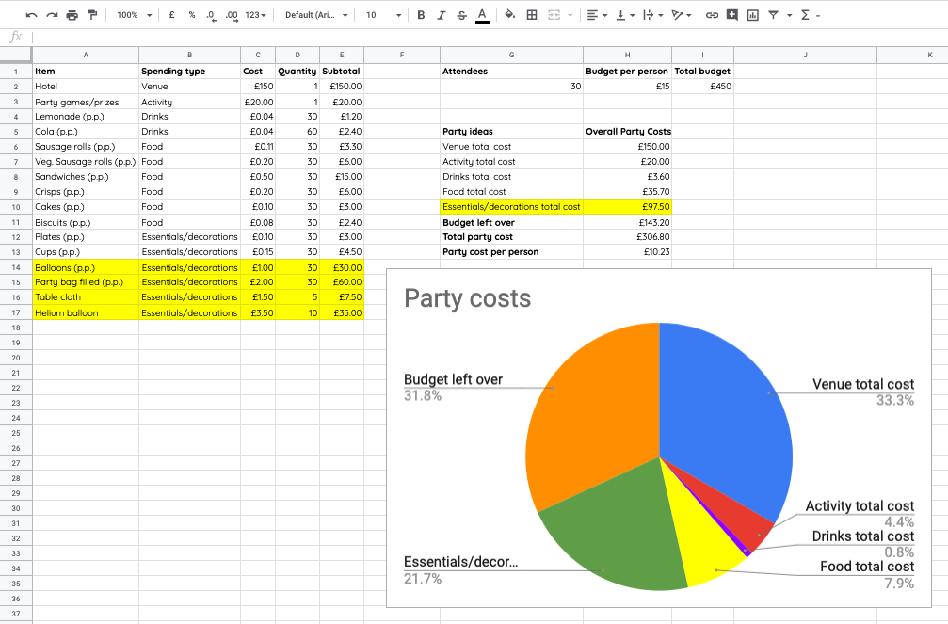
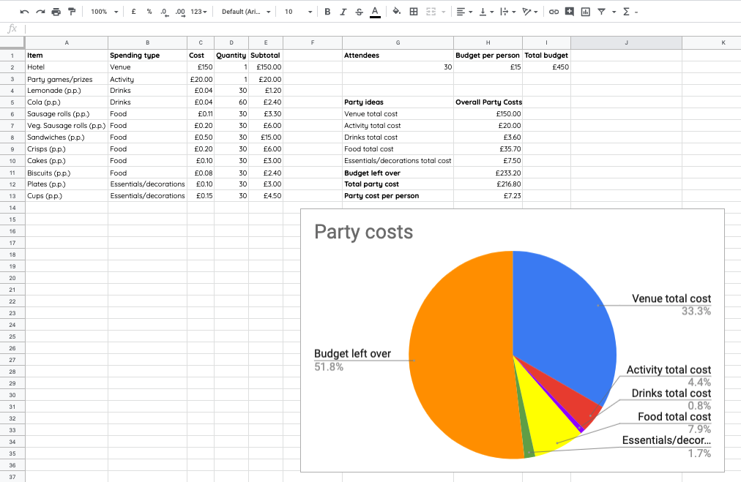
Creating graphs
Plenary
What would happen to the pie chart if you spent more money on essentials and decorations?
The essentials/decoration section of the pie chart would be bigger as more money was spent in this area.
When you make changes to the spreadsheet this is reflected in the chart.

Slide 17
How confident are you? (1–3)
Assessment
I can use a spreadsheet to answer questions
I can explain why data should be organised
I can apply a formula to calculate the data I need to answer questions
3 - Very confident
2 - Unsure
1 - Not confident
Notes:
Image source: https://pixabay.com/vectors/thumb-up-hand-like-confirm-go-top-307176/

Slide 18
Next lesson
Summary
In this lesson, you…
Created a spreadsheet to plan an event
Used a formula to populate cells
Next lesson, you will…
Choose suitable ways to present your data

