Slide 1
Lesson 5:
Breaking things down
Save a copy
Repetition in shapes
Notes:
Last updated: 01-07-20
This resource is available online at ncce.io/pg4a-5-s. Resources are updated regularly — please check that you are using the latest version.
This resource is licensed under the Open Government Licence, version 3. For more information on this licence, see ncce.io/ogl.

Slide 2
Lesson 5: Breaking things down
Objectives
To decompose a program into parts
I can identify ‘chunks’ of actions in the real world
I can use a procedure in a program
I can explain that a computer can repeatedly call a procedure

Slide 3
Rearrange the commands to make code for a hexagon
Introduction
[ ]
repeat
6
fd
100
60
rt
repeat 6 [fd 100 rt 60]
Notes:
Ask pupils to write the commands in the correct order on their whiteboards. Click to reveal the answer — repeat 6 [fd 100 rt 60]

Slide 4
Getting ready for PE
Activity 1
The task of getting ready for PE has lots of different parts, eg going to get PE kit, taking off shoes, etc.
Can you decompose the action of getting ready for PE by breaking it into smaller parts?
Notes:
Image source: https://pixabay.com/photos/sport-leisure-football-training-3891579/

Slide 5
Getting ready for PE — decomposed
Activity 1
Get PE bag from peg
Come back to your desk
Take off uniform
Put uniform on chair
Put on top
Put on shorts
Put on trainers
Sit on the carpet
Notes:
A possible solution for the task

Slide 6
Decomposing everyday tasks
Activity 1
Choose one of the tasks below and decompose it by breaking it into smaller parts. Work with a partner, and write the parts on your whiteboard.
Getting ready for school
Washing your hands
Getting dressed
Getting ready for bed
Making a sandwich

Slide 7
Decomposition in programming
Activity 1
When we think about what we need to program, we can also decompose our task into smaller parts.
For example, when planning how to draw a hexagon, we can break it down into these parts:
Clear the screen
Go forward 100
Turn right 60 degrees
Repeat steps 2 and 3 six times
repeat 6 [fd 100 rt 60]

Slide 8
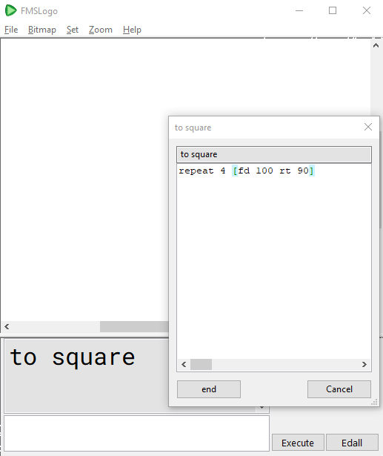
Creating procedures
Activity 2
A procedure is a named code snippet that can be run multiple times.
Creating a procedure will mean that we will save time later on, as we will run the whole code snippet by just typing the one word that we used as a procedure name.

Slide 9
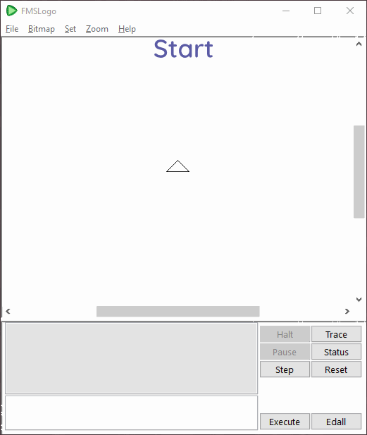
Creating a procedure for a square
Activity 2
Notes:
Play the animation, or demonstrate in Logo how to create a procedure to make a square.

Slide 10
Creating procedures
Activity 2
To write a procedure for a square:
TO square
repeat 4 [fd 100 rt 90]
END
Notes:
The procedure name and values in bold need to be modified each time pupils create a new shape.
Note: If you are using Turtle Academy, the procedure must be written all on one line, rather than on three lines.

Slide 11
Creating procedures
Activity 2
To write a procedure for a triangle:
TO triangle
repeat 3 [fd 100 rt 120]
END
Notes:
The procedure name and values in bold need to be modified each time pupils create a new shape.
Note: If you are using Turtle Academy, the procedure must be written all on one line, rather than on three lines.

Slide 12
Creating procedures
Activity 2
Write procedures for two or three shapes, giving them appropriate names, eg:
square
triangle
pentagon
hexagon
rectangle
Test each procedure after you have created it, to check that it works.

Slide 13
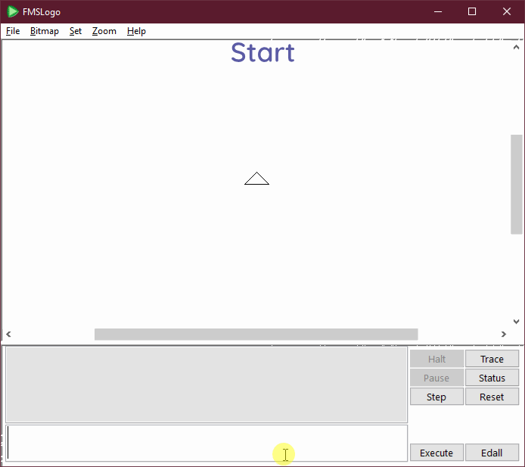
Using procedures to make patterns
Activity 3

Slide 14
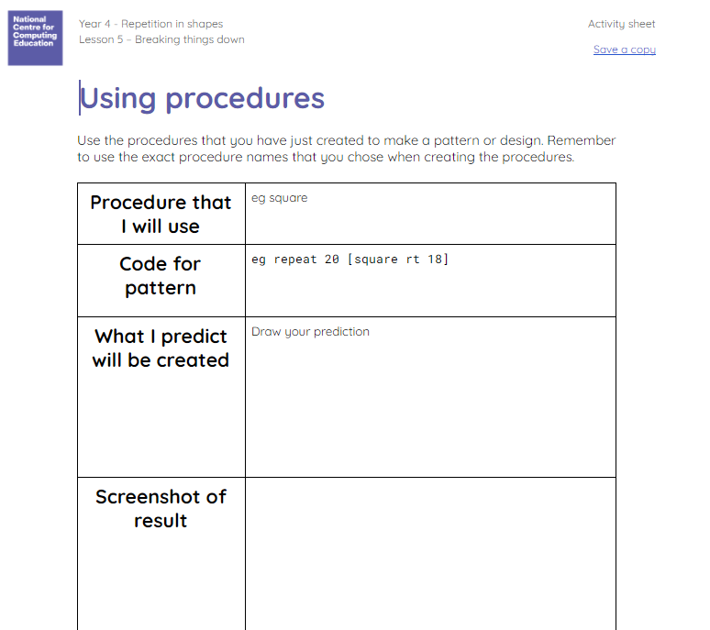
Using procedures to make patterns
Activity 3
Task:
Plan to use one (or more) of your procedures within a pattern
Write down the code that you will use
Predict what will be drawn
Run the code in Logo
Add a screenshot of your work
Reflect on the outcome
Save your document

Slide 15
Breaking things down
Plenary
This procedure is called ‘cat’.
TO cat REPEAT 4 [FD 100 RT 90] END
Discuss with a partner:
What does it draw when we call it?
Does it matter to the computer what it is called?
Does the computer follow the commands programmed, no matter what the procedure is called?
Notes:
Create a procedure with any random name you like, eg ‘cat’. Program the cat procedure to create a square — TO cat repeat 4 [fd 100 rt 90] END
What does it draw? (Answer: A square)
Does it matter to the computer what it is called? (Answer: No)
Does the computer follow the commands programmed, no matter what the procedure is called? (Answer: Yes)

Slide 16
Assessment
How confident are you? (1–3)
I can identify ‘chunks’ of actions in the real world
I can use a procedure in a program
I can explain that a computer can repeatedly call a procedure
3 – Very confident
2 – Unsure
1 – Not confident
Notes:
Image source: https://pixabay.com/vectors/thumb-up-hand-like-confirm-go-top-307176

Slide 17
Next lesson
Summary
In this lesson, you…
Decomposed real-life activities and code snippets into smaller parts
Created procedures for shapes
Used your procedures to create patterns
Next lesson, you will…
Design, create, and debug a program that uses count-controlled loops

