Slide 1
Monday Maths
(Starter) O LO: Can I recap my knowledge of converting units of measure like mass (kg and g)?
(Main) O LO: Can I start to interpret line graphs and describe the information that they show?

Slide 2
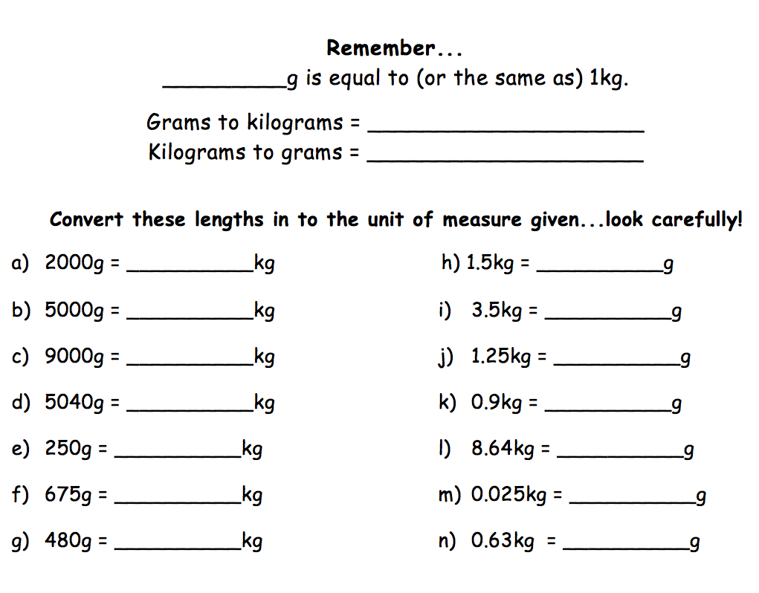

Slide 3
x-axis
y-axis
Line graphs
Title

Slide 4
Can you describe what this graph is trying to show?
This is a graph to show...

