Slide 1
Class 1 Maths
Thursday 11th February 2021
Measuring height

Slide 2
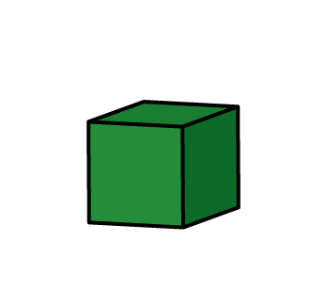
How tall is the sunflower now?

Slide 3
How tall is the sunflower now? It was two blocks tall. How many more blocks has it grown by?

Slide 4

How tall is the sunflower now? It was three blocks tall. How many more blocks has it grown by?

