Slide 1
Maths Tuesday – Friday Conversions recap and line graphs

Slide 2
02/01/21 (Starter) O LO: Can I recap my knowledge of converting units of measure like capacity (ml, l and cl)? (Main) O LO: Can I continue to interpret line graphs and use them to solve problems/answer questions?

Slide 3
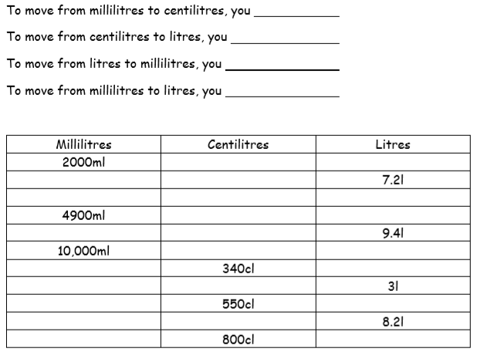
÷ 10
÷ 100
Top tip:
We will be dividing or multiplying by 10’s, 100’s, 1000’s etc. so use those place value grids!
x 1000
÷ 1000

Slide 4
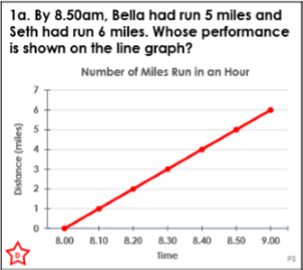
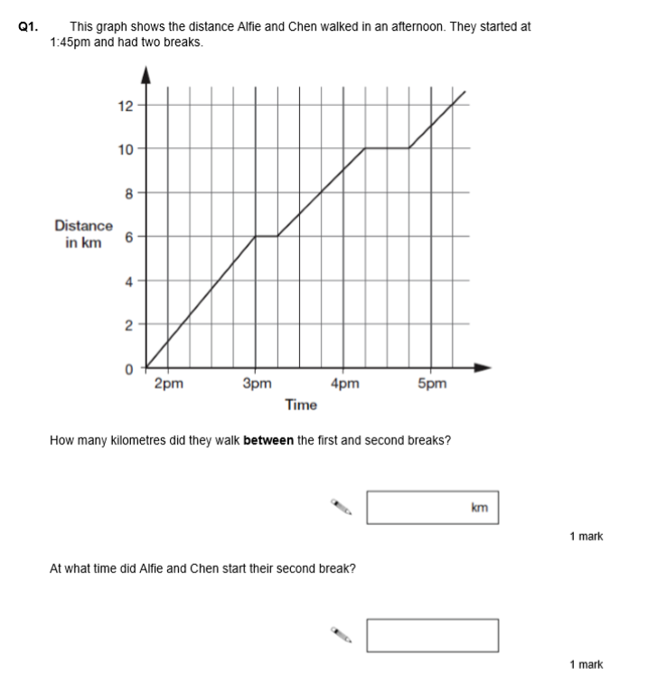

Slide 5
03/01/21 (Starter) O LO: Can I recap my knowledge of converting units of measure like distance (cm and m)? (Main) O LO: Can I start to construct line graphs from given data?

Slide 6
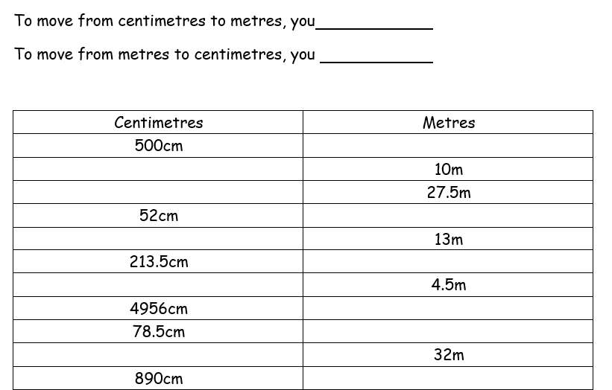
÷ 100
x 100
Top tip:
We will be dividing or multiplying by 10’s, 100’s, 1000’s etc. so use those place value grids!

Slide 7
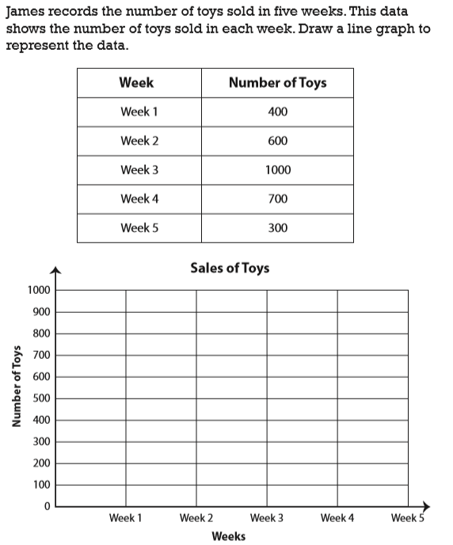
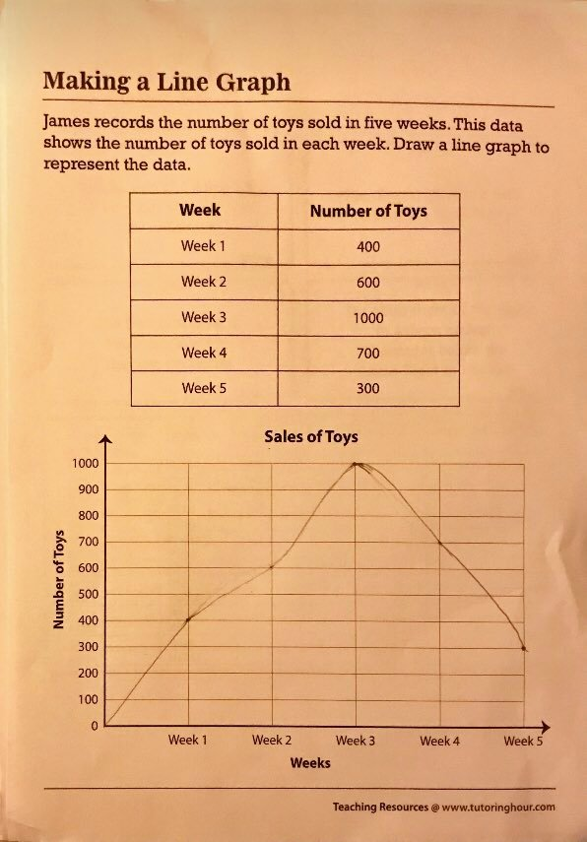

Slide 8
04/01/21 (Starter) O LO: Can I recognise that shapes with the same area sometimes have different perimeters? (Main) O LO: Can I continue to draw line graphs and start to solve problems with the data shown?

Slide 9
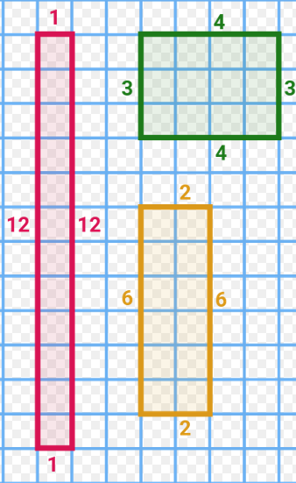
Starter:
What do you notice about the shapes below in terms of their area and perimeter?
Work out each area and perimeter
to help you answer this question.

Slide 10
What is the difference between how many toys James sold in Week 3 and Week 1?
Hint: just like we would if we were reading coordinates, you should move along the corridor and up the stairs to read data from the graph!

Slide 11
05/01/21 O LO: Can I use my problem solving skills to solve a maths puzzle involving time?

Slide 12
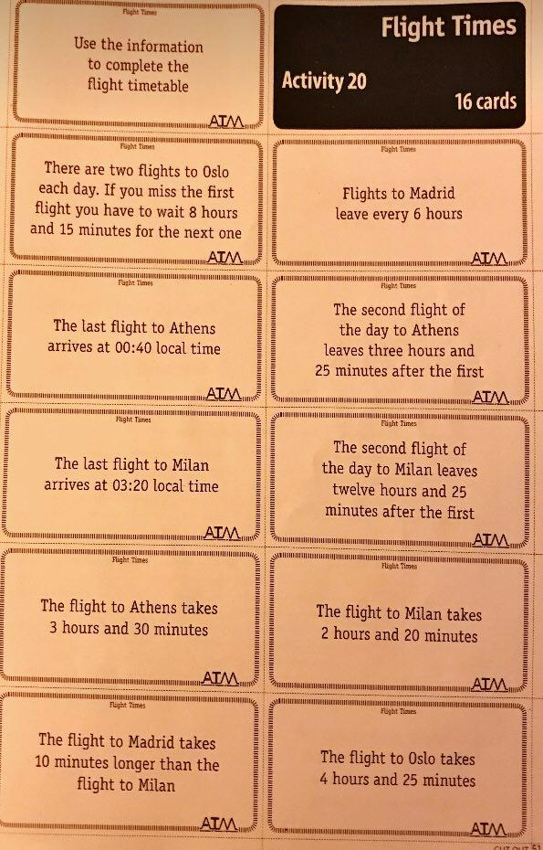
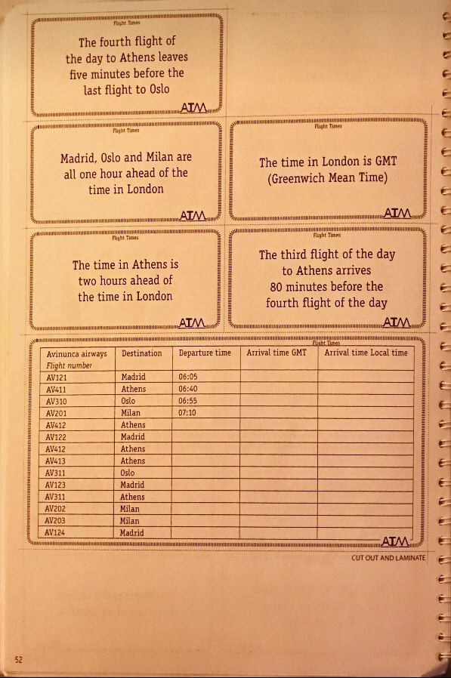
This is your challenge. Use the clues to help you work it out!
Present your answers in this table. You can re-draw it if needed.

