Slide 1
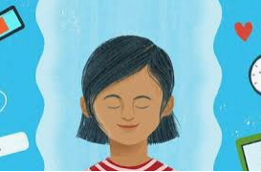
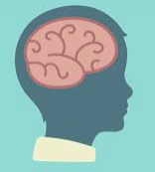
Mindfulness and the Brain.
In, hopefully, an easy to understand way.
Material Credit:

Slide 2
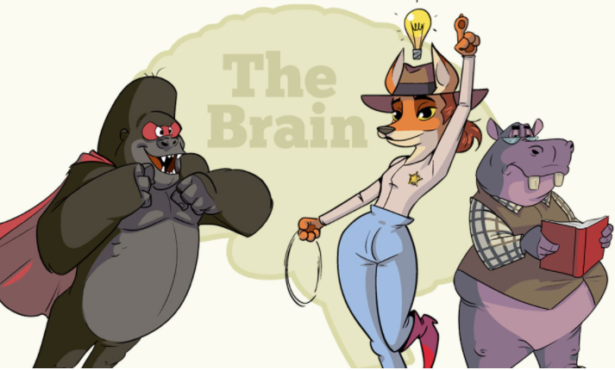
Explaining how mindfulness and the brain works can seem like a daunting task.
Yet it can be one of the best ways to show how mindfulness works for us and how it helps our brain to function properly.

Slide 3
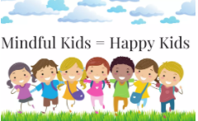
When you learn about the major parts of the brain…
You will be astounded because you understand:
why you get angry,
why it is hard to calm down,
and why you do strange things that you later regret.
When you understand that it’s not always your fault when you do crazy things … and that you can become less reactive—even at times when life pushes your buttons!!

Slide 4
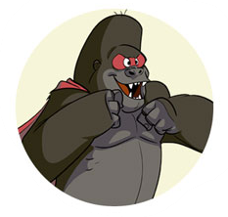
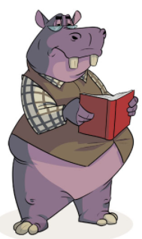
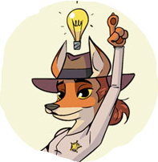
Here is a simpler way to explain the brain to children…
Here the relevant parts of the human brain are renamed like this:
The Amygdala = Amy
The Hippocampus = Hippo
The Pre-Frontal-Cortex = Tex
You can make them into fun animal characters:
Introducing the hippo, fox and gorilla.

Slide 5
Keep reading and I’ll explain:
1. The key players in our brains.
2. What they do for us.
3. How we can help them do a better job for us.
So that we get to decide how to respond in difficult situations …
… instead of reacting based on emotions alone.
The human brain is pretty amazing :)

Slide 6
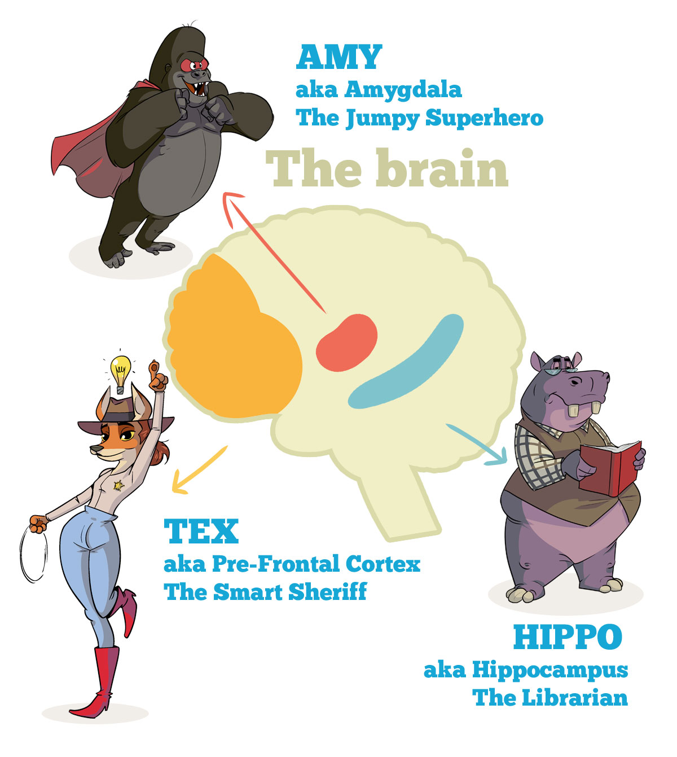
MINDFULNESS AND THE BRAIN:

Slide 7
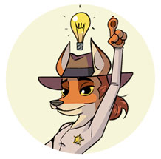
TEX THE SMART SHERIFF
The Pre-frontal cortex (or TEX for short) is a newer part of the brain that helps us deal with emotions and make wise decisions.
She figures out stuff for you and helps you make good choices. She’s there to stop you from doing crazy things, for your own good.
Tex is like a smart sheriff in your brain.
Tex helps us to deal with:
thoughts,
emotions,
and our actions in relation to our goals.
She helps us plan and make good decisions.
And she helps us with impulse control too, to overcome temptations.
She’s important and you want to take care of her.

Slide 8
HOW TEX HELPS US
When we experience a thought or an emotion, Tex asks:
“Will this help us to reach our goals?”
If the answer is no … then Tex will stop you from acting. From doing crazy stuff.
If the answer is yes (as in this will help you reach your goals) … then Tex will allow you to act.
This is how the prefrontal cortex or Tex does her work.
Sort of like a sheriff in your brain.

Slide 9
Now … this how it works in real life…
Here’s a question for you:
Have you ever wanted to say something … but you realized that saying it would only make things worse?
Has that happened to you?
I’m sure it has. And if you bit your tongue and managed to not make things worse… then Tex was able to help you.
Go, sheriff!
How about this:
Have you ever felt really emotional and said something awful … something you wished you could take back?
Of course you have. We all have.
Okay, so … at that time Tex was not able to help you.
Oh no!

Slide 10
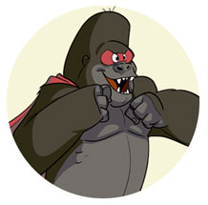
But … why not?
This happened most likely because another, older part of your brain called the Amygdala believed that the stress you were experiencing was a real threat to you.
The Amygdala didn’t let Tex do her job!
AMY
THE JUMPY SUPERHERO!!

Slide 11
AMY THE JUMPY SUPERHERO
The Amygdala (Amy) is like a jumpy superhero who tries to protect you at all costs, but often mistakes stress for real threats … and effectively stops Tex from doing her job.
Now why do we have something like this going on in our fancy brains?
What is this?
It’s called …

Slide 12
THE FIGHT FLIGHT FREEZE RESPONSE
During a stress response, we disconnect from rational thinking.
We shift gears to an impulsive, reactive “fight, flight, freeze” mode.
We lose connection to some of our higher brain functions like:
self regulation, memory, and mental flexibility.
We have a hard time …
focussing,
remembering instructions (like conflict resolution skills),
controlling impulses,
and making good choices.

Slide 13
This is how evolution has wired our brains!
Our brains have evolved to react to danger and overwhelm this way.
WHY?
A long time ago when wild animals hunted us, our brains helped us survive by reacting automatically and instantly to danger.
This ancient part of our brains (the Amygdala) still sounds the alarm whenever it believes we are in imminent danger ….
…and when the alarm goes off our bodies prepare to FIGHT, BOLT OR FREEZE.
The alarm goes off when we face overwhelming or strong emotions like fear, anger and sadness.
Like for example:
when someone says something unkind to you, you get all upset and the Amygdala—
the ancient part of your brain—believes you are in danger.

Slide 14
ALARM ALARM ALARM
A child might say something cruel or unkind when they feel upset.
A child might push another kid or a parent when they get angry.
A child might freeze at school when overwhelmed.
A parent might yell at his child.
(I know I have raised my voice … and I hate it)
It’s really hard to make good choices or speak eloquently when your body forces you to fight, bolt, or freeze.
It’s no wonder children (and grown-ups) do crazy things when this happens.
And in a way it’s really not the child's fault when it happens. Or yours!

Slide 15
But, how does all this relate to mindfulness practice?
This is the important part :-)
This is how … (and this is the ‘science-ey’ bit)
Several studies have shown we can practise mindfulness to activate Tex (the Prefrontal Cortex) and Hippo (the Hippocampus), and reduce activation in Amy (the Amygdala). Research also suggests that mindfulness can help Tex and Hippo grow bigger.

Slide 16
But, how does all this relate to mindfulness practice?
Most studies on the brain science of mindfulness have been done on adults, but early research suggests that mindfulness might have similar effects on Tex, Amy and Hippo for children.
In fact, some argue that mindfulness training is especially important for children, because the prefrontal cortex (Tex) doesn’t reach full maturity until around age 25.
Tex’s development is strongly influenced by childhood experiences, and mindfulness training might be an effective way to help Tex grow up and do her job.

Slide 17
This way Tex & Hippo can help kids:
control their attention,
manage and respond to emotions and thoughts,
and control impulses.
So that they can better deal with difficult emotions and thoughts and ultimately make better decisions.

Slide 18
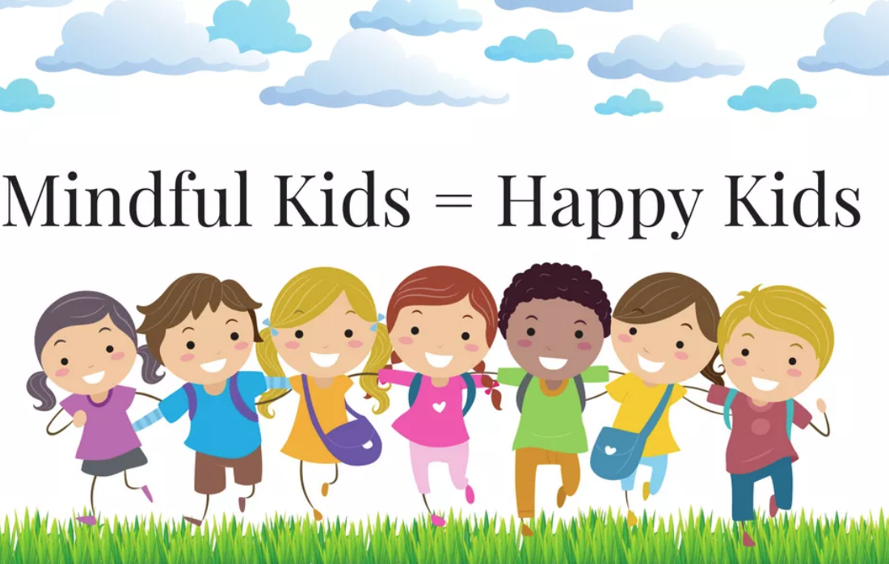
Mindfulness also soothes Amy the Amygdala—
the part of the brain, as we have learned, that gets aroused reacting to emotions.
And studies have shown that people who are more mindful have smaller amygdalas.
To sum it all up, mindfulness helps us double-check “bottom-up” reactions that come from Amy with “top-down” attention from Tex so that we can regulate and balance our thoughts and behaviour.
And Hippo helps us store this information for later use.

Slide 19
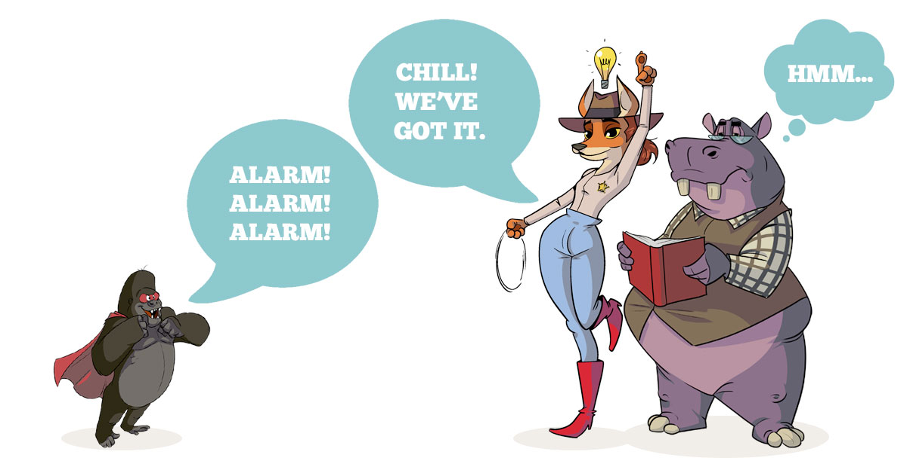
Pretty cool, right?
When we’re mindful, we get to decide how we respond to life’s challenges and we can make good choices more easily.

Slide 20
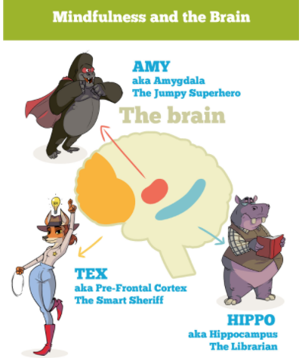

Slide 21
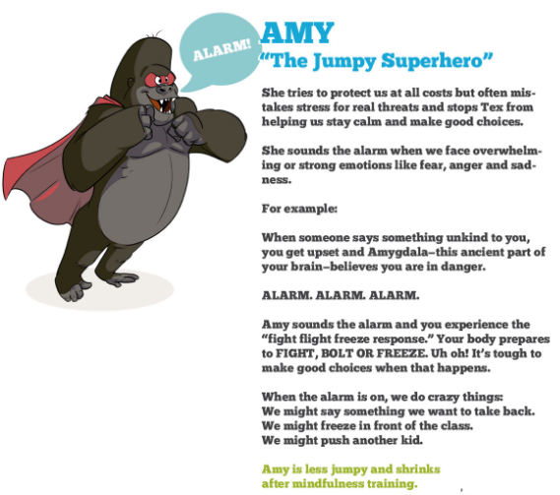

Slide 24
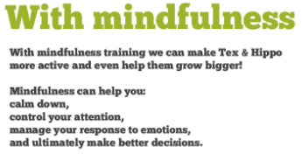
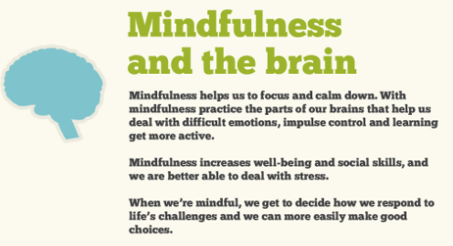
Have fun! I hope that you enjoyed this way of explaining mindfulness and the brain.

Slide 25
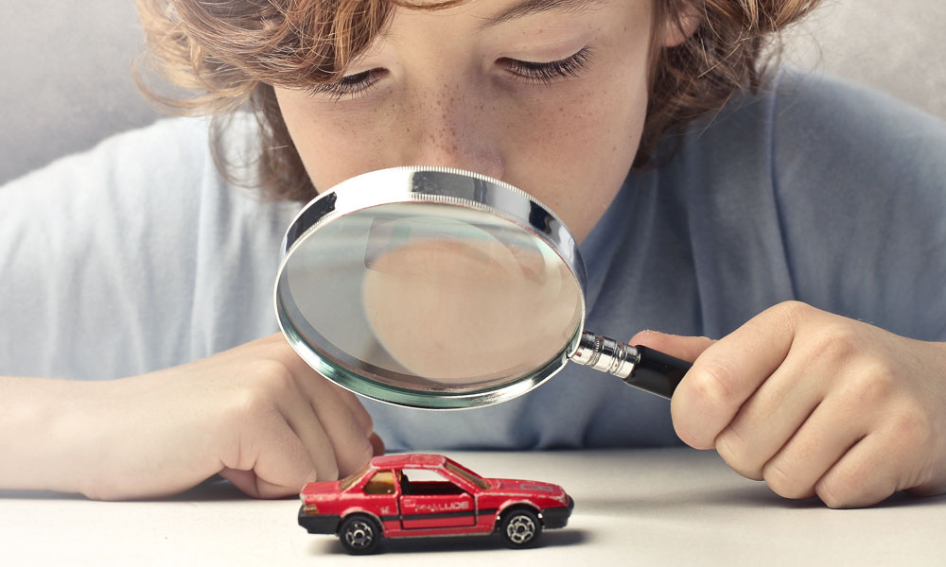
THREE SENSES MINDFULNESS ACTIVITY FOR KIDS, TEENS AND GROWN-UPS:
Purpose: Mindfulness of Sounds, Surroundings and Body, Focus, Awareness, Calm. Best for: Ages 5+, groups or one-on-one. What you need: Nothing
To begin, tell your child that they can focus on their senses to calm their body and mind. That you will pay attention to sound, sight and touch to try this out.
Explain that they will simply pay attention to their senses when you ask questions. You can talk about what they noticed when you’re done, and they should try to be silent and pay attention during the activity. It’s easier and more fun that way.
Next, take five slow breaths together and ask your child:
1. What are three things you can hear?
2. What are three things you can see?
3. What are three things you can feel?
Give them about 20-40 seconds per question.
When you are done, ask them what they noticed per question.
Perhaps they heard a clock, saw a painting, and felt the chair under them and so on.
Ask how this activity made them feel.
Could they use this skill when they’re bored or anxious? When might that be?
Credit: blissfulkids.com

