Slide 1
Class 1 Maths
Thursday 4th February 2021
I spy

Slide 2

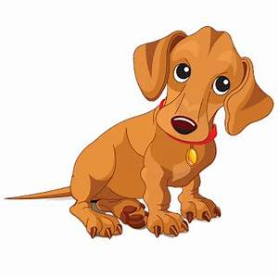

Groups
I spy a group of 3. I spy a group of 4. What am I looking at?

Slide 3
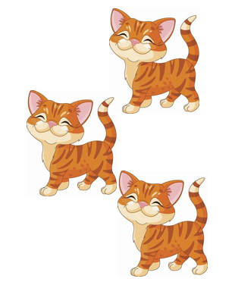
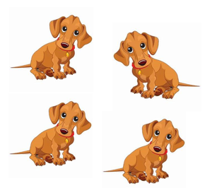
How many are there altogether?
We are going to use a part, part whole model to represent the number of dogs and cats and find out how many we animals have altogether.

Slide 4
Part part whole model
This is a part part whole model. It helps us see how we can split numbers up into parts.
For example if Poppy had two sweets and Flo had two sweets, we could represent these on the model as two dots in each of the bottom circles (the parts).
We could then find out how many sweets they have altogether by counting them all (the whole).
The whole
A part
Poppy
Flo

Slide 5

We are going to represent the dogs and cats using blue dots. How many dots do we need to represent the dogs?
How many to represent the cats?
We can now see that four is a part and three is a part.
How many is the whole?
The whole is 7. There are seven cats and dogs altogether.

Slide 6
Your turn…
Now it is your turn. Can you complete the part part whole model to show me how many goldfish and cats there are altogether. Remember, the cats are a part and the goldfish are a part.
Send me your results on Class Dojo!

