Slide 1
Lesson 5: Debugging movement
Save a copy
Programming – Events and actions in programs
Notes:
Last updated: 01-07-20
This resource is available online at ncce.io/pg3b-5-s. Resources are updated regularly — please check that you are using the latest version.
This resource is licensed under the Open Government Licence, version 3. For more information on this licence, see ncce.io/ogl.

Slide 2
Lesson 5: Debugging movement
Objectives
To identify and fix bugs in a program
I can test a program against a given design
I can match a piece of code to an outcome
I can modify a program using a design

Slide 3
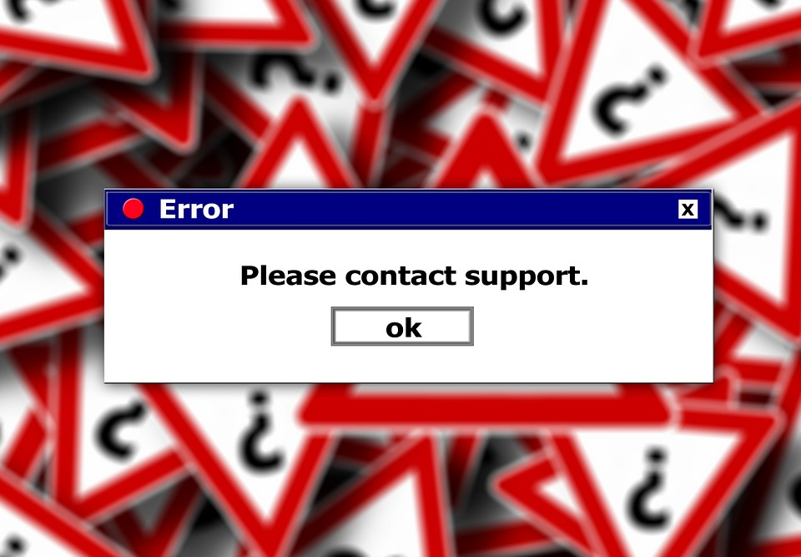
Why do we need to debug?
Introduction
When have you made a program and found that it doesn’t work in the way you would like?
Think, pair, share.
Notes:
Image: https://pixabay.com/illustrations/error-www-internet-calculator-102075/

Slide 4
Debugging a project
Activity 1
Go to this project: ncce.io/pg3b-5-a1-ca

Slide 5
When green flag clicked — what’s the problem?
Activity 1
When the green flag is clicked, the pencil should move to the centre, the pen colour should be set to blue, and all lines should be erased.
A
The sprite does not move to the centre
B
The lines are not erased
C
The pen is set to the wrong colour
Notes:
Screenshot from Scratch 3.0

Slide 6
When green flag clicked — what’s the problem?
Activity 1
When the green flag is clicked, the pencil should move to the centre, the pen colour should be set to blue, and all lines should be erased.
A
The sprite does not move to the centre
B
The lines are not erased
C
The pen is set to the wrong colour
Notes:
Screenshot from Scratch 3.0

Slide 7
When green flag clicked — how to fix it
Activity 1
Add an erase all block.
Notes:
Screenshots from Scratch 3.0

Slide 8
When left arrow key pressed — what’s the problem?
Activity 1
When the left arrow key is pressed, the sprite should point to the left and move 10 steps.
A
The sprite moves right
B
The sprite does not move
C
The sprite moves down
Notes:
Screenshot from Scratch 3.0

Slide 9
When left arrow key pressed — what’s the problem?
Activity 1
When the left arrow key is pressed, the sprite should point to the left and move 10 steps.
A
The sprite moves right
B
The sprite does not move
C
The sprite moves down
Notes:
Screenshot from Scratch 3.0

Slide 10
When left arrow key pressed — how to fix it
Activity 1
What do you need to do?
Add a block?
Change a block?
Remove a block?
Notes:
Screenshot from Scratch 3.0

Slide 11
When left arrow key pressed — how to fix it
Activity 1
Change point in direction 90 to point in direction -90
Notes:
Screenshot from Scratch 3.0

Slide 12
When up arrow key pressed — what’s the problem?
Activity 1
A
The sprite moves right
When the up arrow key is pressed, the sprite should point upwards and move 10 steps.
B
The sprite does not move
C
The sprite moves down
Notes:
Screenshot from Scratch 3.0

Slide 13
When up arrow key pressed — what’s the problem?
Activity 1
A
The sprite moves right
Can you fix it in your project?
B
The sprite does not move
C
The sprite moves down
Notes:
Screenshot from Scratch 3.0

Slide 14
Now debug the other errors on your worksheet
Activity 1
Write down the problem
Write down how to fix it
Fix it in the project
Notes:
Screenshot from Scratch 3.0

Slide 15
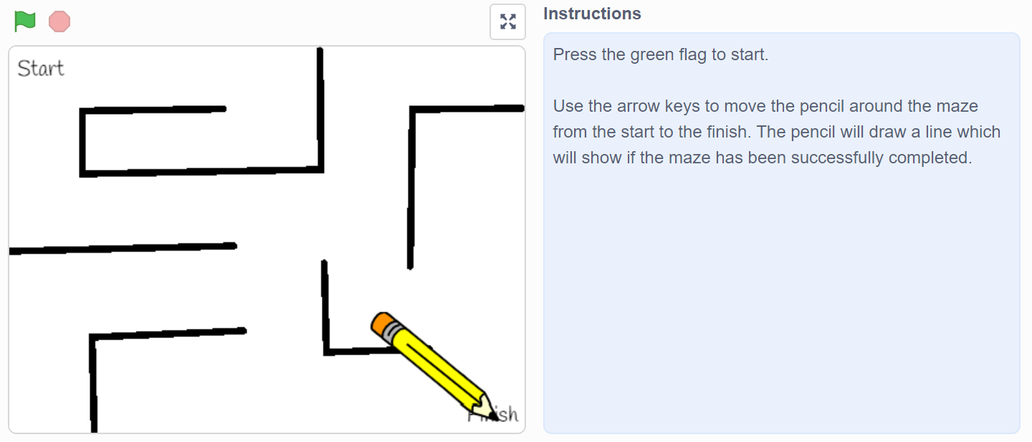
Find the bugs
Activity 2
There are four bugs in this program. Can you find them?
ncce.io/pg3b-5-a2-ca
Notes:
Screenshot from Scratch 3.0 project at ncce.io/pg3b-5-a2-ca

Slide 16
Bugs in this project
Activity 2
The sprite starts in the wrong place in the maze
The line drawn is too thick
There is no erase all block in the setup process, so the sprite draws a line whenever it is moved, and the lines never disappear
The sprite has not been recentred, so the line is drawn from the middle of the pencil, not the point
Can you fix the bugs?

Slide 17
Modifying a program using a design
Activity 3
Use the design below to modify the program.
Start the pencil at x: -150, y: 150
Clear all lines on the screen
Centre the sprite on the tip of the pencil
Select pen size 1, 2, 3, 4, or 5 by using those keys on the keyboard
Save your project.

Slide 18
Steps to effective debugging
Plenary
Here are five steps to effective debugging, but they are in the wrong order.
Can you arrange them correctly?
Identify the bug
Test the bug fix — does the code now do what it should?
Fix the bug
Test the project
Review the task — what should the project do?

Slide 19
Steps to effective debugging — answer
Plenary
Here are five steps to effective debugging, but they are in the wrong order.
Can you arrange them correctly?
Review the task — what should the project do?
Test the project
Identify the bug
Fix the bug
Test the bug fix — does the code now do what it should?

Slide 20
Assessment
How confident are you? (1–3)
I can test a program against a given design
I can match a piece of code to an outcome
I can modify a program to match a design
3 – Very confident
2 – Unsure
1 – Not confident
Notes:
Image source: https://pixabay.com/vectors/thumb-up-hand-like-confirm-go-top-307176

Slide 21
Next lesson
Summary
In this lesson, you...
Tested your program, debugged it by correcting errors, and then modified your design
Next lesson, you will…
Create, test, and debug your own program to move a character around a maze

